Slide 1
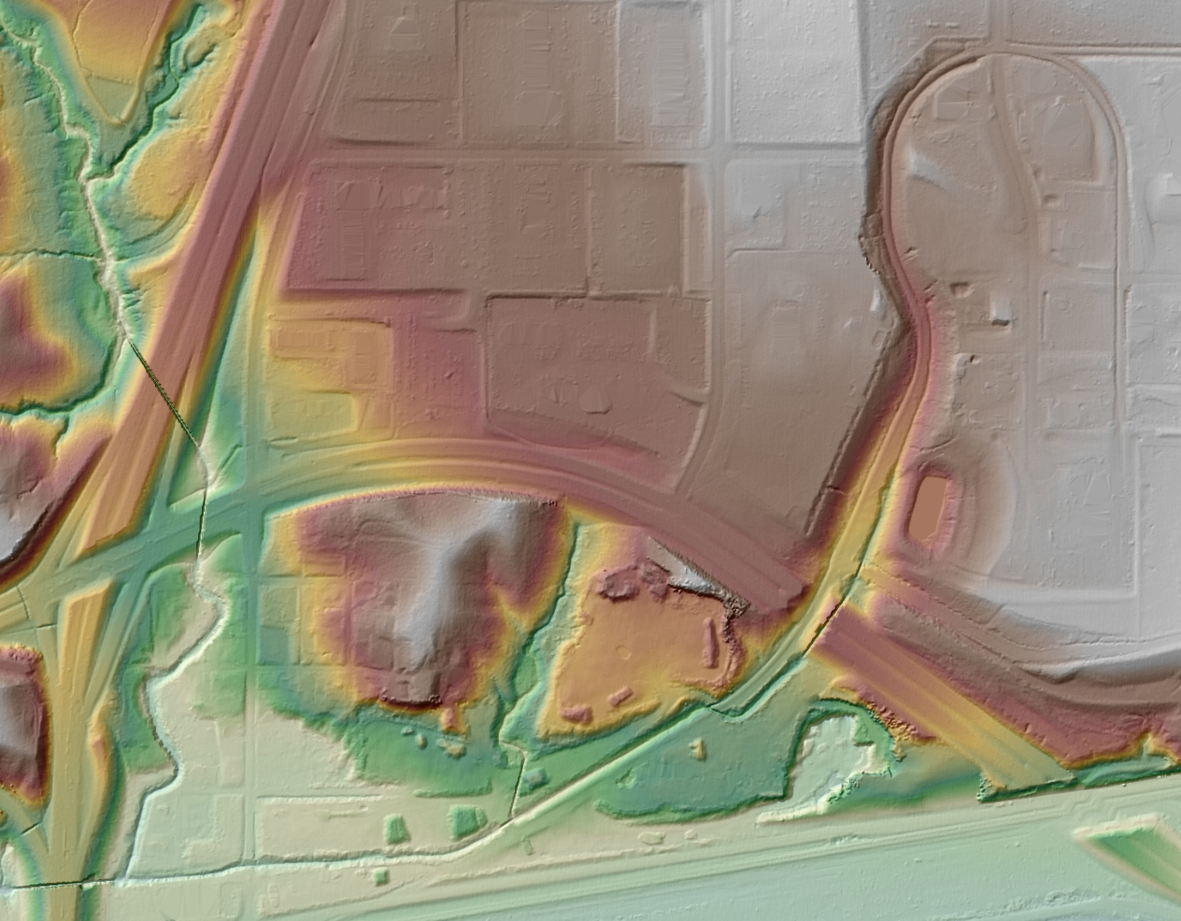
Acquisition and Processing of LiDAR Data
Merrick & Company
Kenny Legleiter
Senior Government Account Manager

Slide 2

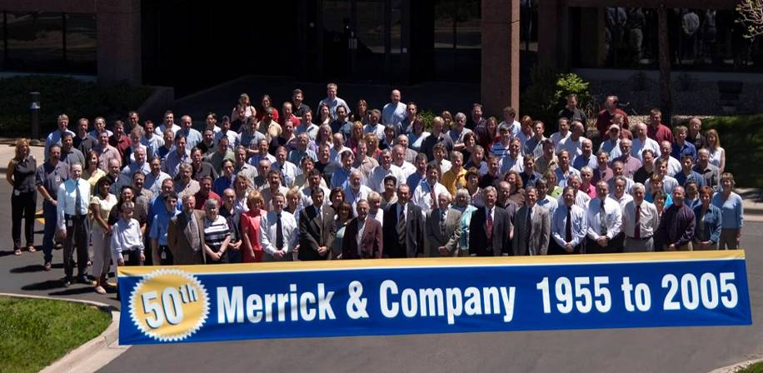
Merrick & Company
World Headquarters: Aurora, Colorado
Founded in 1955
Primary Services:
    GeoSpatial Solutions
    Surveying
    Architecture
    Civil Engineering
    Facilities Engineering
    Process Engineering
470 employees within 8 national and international offices
Annual revenue = $60M
Ownership: Private (employee-owned)
Notes:
Brief company history – some background, why we know LiDAR

Slide 3
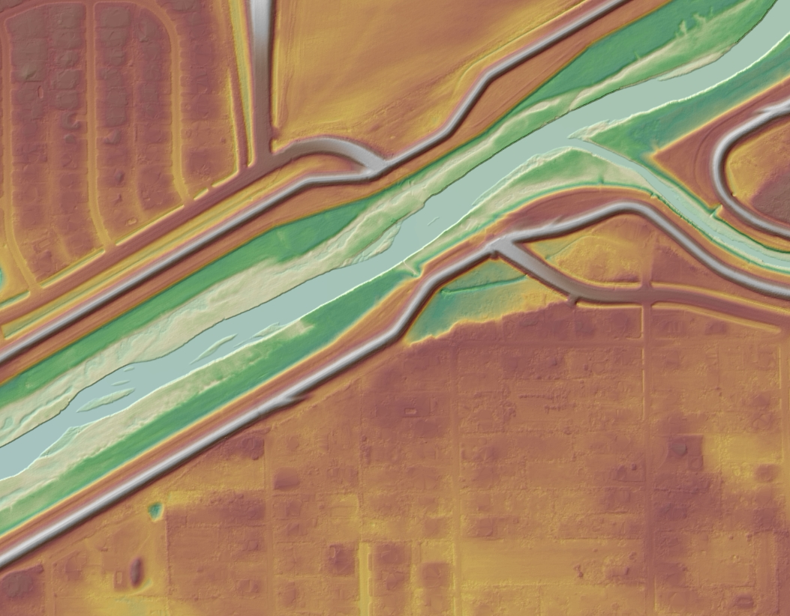
Flight Planning
How are LiDAR Projects Planned?

Slide 4

Flight Planning
Considerations and Contributing Factors:
Planned altitudes based on accuracy, terrain and morphology
(i.e., vegetation, urban, etc.)
End user applications
Eye safety considerations (3D planning)
Land use characteristics
Land cover characteristics
Restricted flight areas
Weather factors

Slide 5
Flight Planning (cont.)
Multiple altitudes in high relief areas to maintain accuracy (analogous to scale breaks) and eye safety
Day/Night flying requires multiple crews (pilot, ground support, and operator) – this can become costly
River projects cover more land area then is needed
Predetermine local coordination requirements
For remote areas, planning base station location ahead of time can save a lot of time

Slide 6
Mobilization
Mobilization cost to move aircraft and equipment to project site
Rates usually consist of rate per mile for aircraft plus per diem, labor hours, other cost (hanger, gas, etc.)
Combine multiple projects within a region to lower cost

Slide 7
Flight Mission
Airport coordination
Provide flight plans to FAA and others
Maintain eye safety altitudes
Larger cities more problematic
Restricted airspace surround military and sensitive government buildings (i.e., LANL, White House)
Daily evaluation of data
Fly “patch” lines for missing data

Slide 8
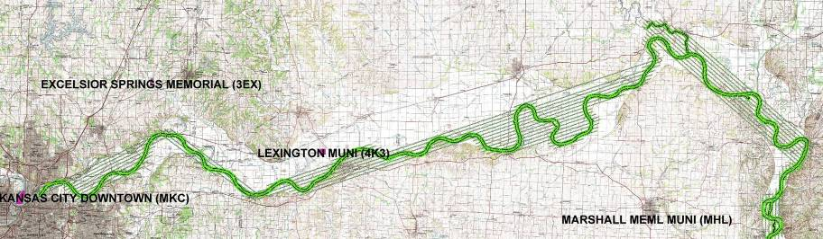
Flight Planning Example
River Corridor Example

Slide 9
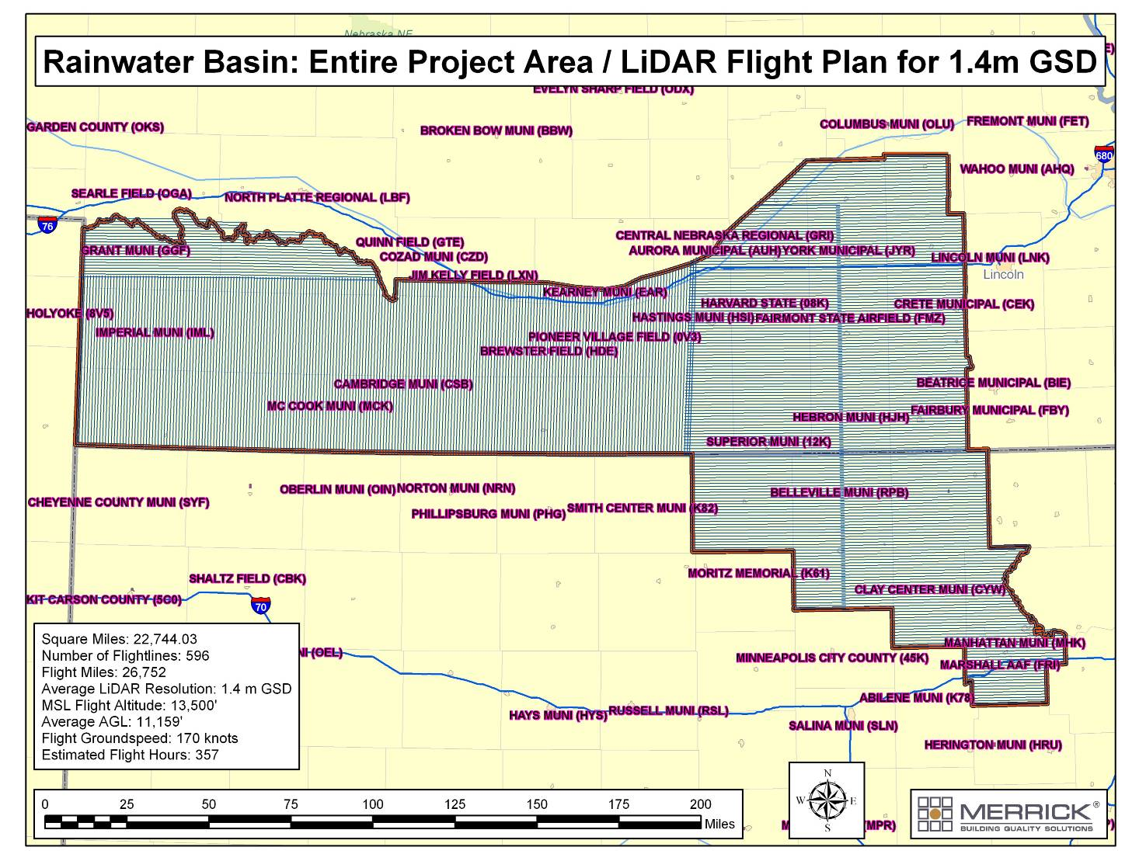
Flight Planning for Large Areas

Slide 10
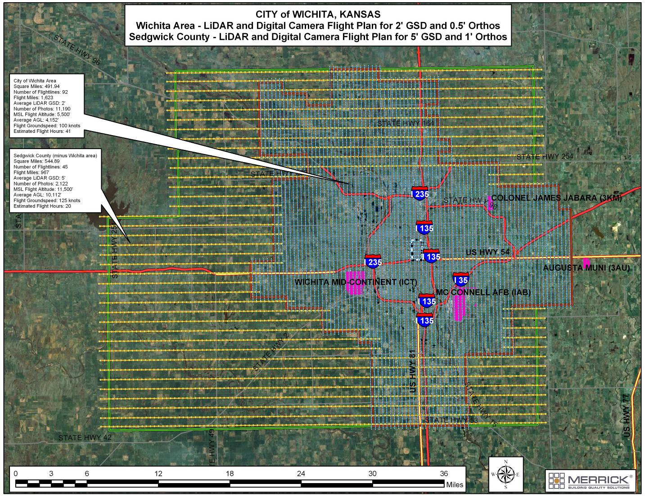
Flight Planning
Different Specifications for different areas

Slide 11
Flight Line Verification
Verify coverage while still on-site
Guarantee all of the project area is covered
Review side overlap for data holidays
Review initial GPS solutions
Review is typically completed at the “home office”
Do not leave site until verification is completed

Slide 12
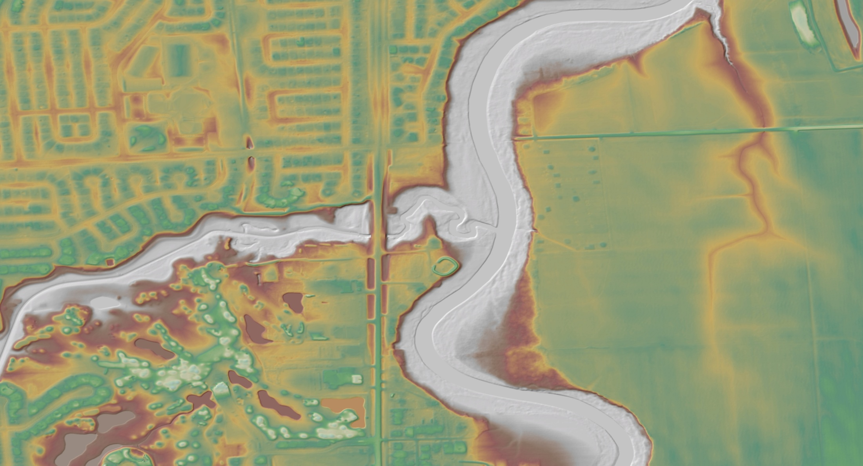
Survey Control

Slide 13
Field Verification
Calibration site
Random survey check points
RTK GPS
Large projects: usually 10-15 checkpoints per 100 square miles
Number and location of check points depends on project configuration

Slide 14
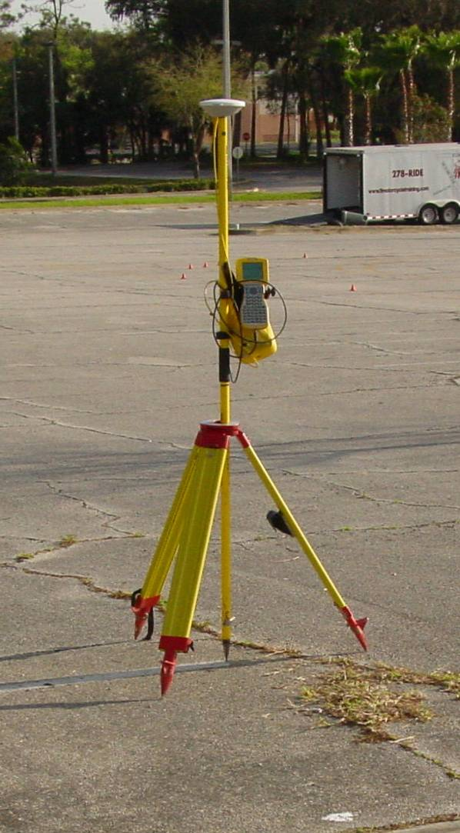
Survey Control
Collection of survey control appropriate for use in LiDAR
  Ground control points collected at places of constant slope, not just
  zero slope
    Points on retaining walls, bridge edges, or any location near a breakline are inappropriate
    Points on zero slope surfaces do not adequately test horizontal accuracy
  Points on surfaces that represent “average reflectivity”
    Control points on very reflective or very dark surfaces may introduce error since LiDAR elevation values are affected by intensity
  Compare LiDAR shots to control with an understanding of the capabilities of the system
    Control collected in areas where LiDAR cannot penetrate should not be confused with accuracy
    Control collected in areas of standing water during the time of LiDAR collection will result in differences of positions since LiDAR does not model water accurately
  Control network has equal distribution and appropriate density throughout the project area
    Control point density of at least 10-15 points per 100 sq miles, with a minimum of 25, for average size projects

Slide 15
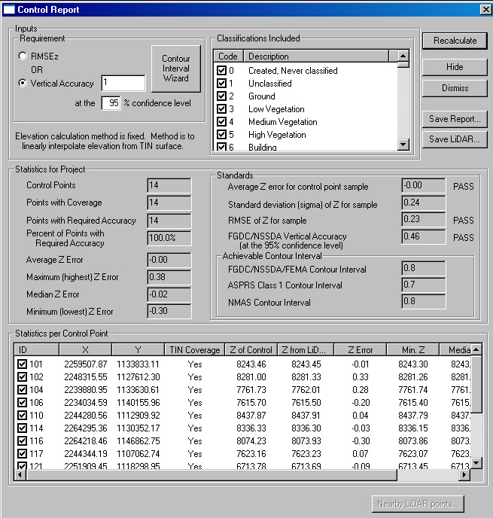
Survey Control Report
Works upon analyzing control point elevations compared to their vertical intersection point of the LiDAR TIN, depending on the user defined classes enabled and disabled
Only reports vertical accuracy
Contour Interval Wizard to choose from:
  FGDC/NSSDA/FEMA
  ASPRS Class 1, 2, or 3
  NMAS
RMSEz or Vertical Accuracy requirement can by manually input
Control is analyzed to TIN of DSM surface
Statistics report:
  Average Z Error
  Median Z Error
  Minimum Z Error
  Maximum Z Error
Standards report for PASS or FAIL for:
  Average Z Error
  RMSEz
  Vertical Accuracy
Achievable Contour Interval report for:
  FGDC/NSSDA/FEMA
  ASPRS Class 1, 2, or 3
  NMAS
Selectable classes to analyze from
Tabular readout of all control information
Export control report to Excel file
Export DSM data for the 3 points forming the TIN of analysis for each control point

Slide 16
Potential Sources of Error
Ground Support
  Erroneous reference station (horizontal or vertical)
  GPS baseline distance too long (25 mile maximum)
  No redundant GPS receivers in case a receiver malfunctions
  GPS base station problems (not enough satellites, incorrect antenna height measurement, battery failure, vandalism, etc.)
  Post-processing error (poor constraint network, lack of local control knowledge, datum transformation, and monument elevation, etc.)
  Operator error

Slide 17
Potential Sources of Error (cont.)
Planning
  Field of view too wide for adequate penetration in vegetation
    Wider the FOV, less accurate on the outside of the flight line, bigger laser footprint, less vegetation penetration
  Too small side overlap could cause data “holiday” or missing data
  Inadequate project procedures and documentation
  Poor communication with internal and external clients
  No field and office data management plan
  No quality control and ground truth plan
  No eye safety plan

Slide 18
Potential Sources of Error (cont.)
Data Holidays, Voids, Etc.
  Laser malfunctions
  Poor flight planning or high cross winds can cause side overlap gaps
  Voids caused by tall buildings (shadows)
  Clouds scatter (below aircraft)
  Water absorption
  Road drop outs (poor SNR/flying to high)
  Vegetation canopy too dense to penetrate
  Low ground cover too dense to penetrate

Slide 19
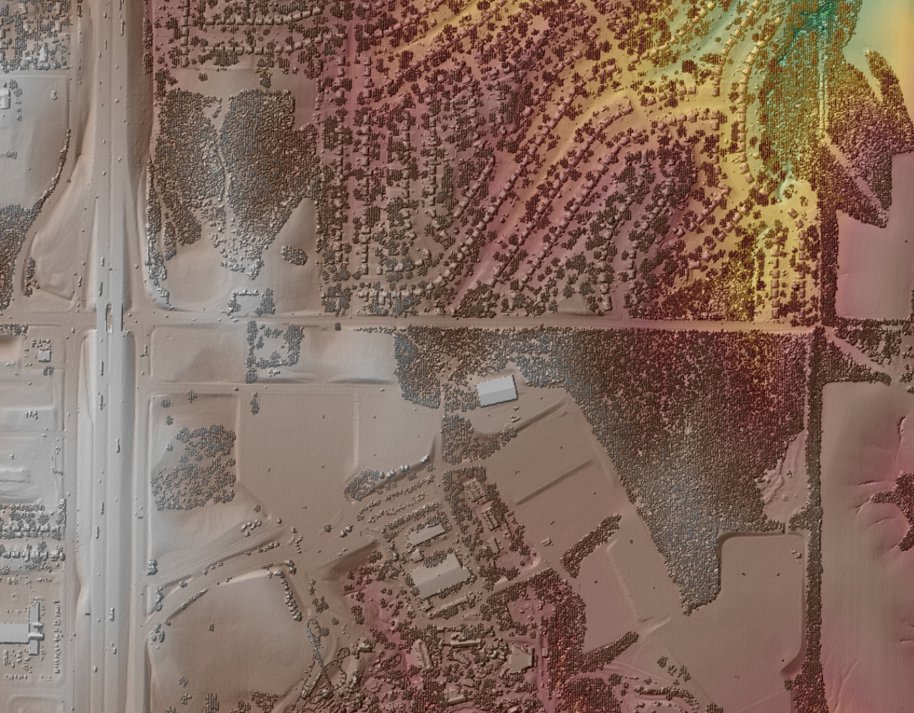
LiDAR Calibration and Boresighting
Why is This Important?

Slide 20
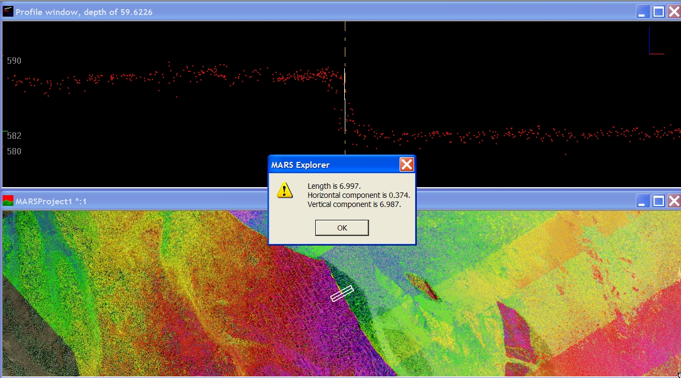
Flight Line Not Calibrated Correctly

Slide 21
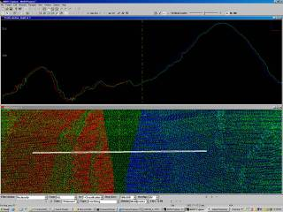
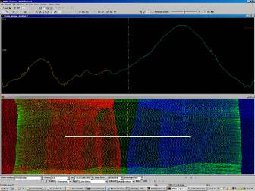
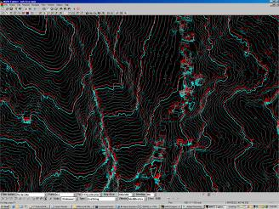
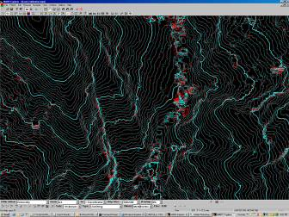
Bore Sighting
(Calibration)
Corrects/adjusts roll, pitch, heading, and dynamic parameters

Slide 22
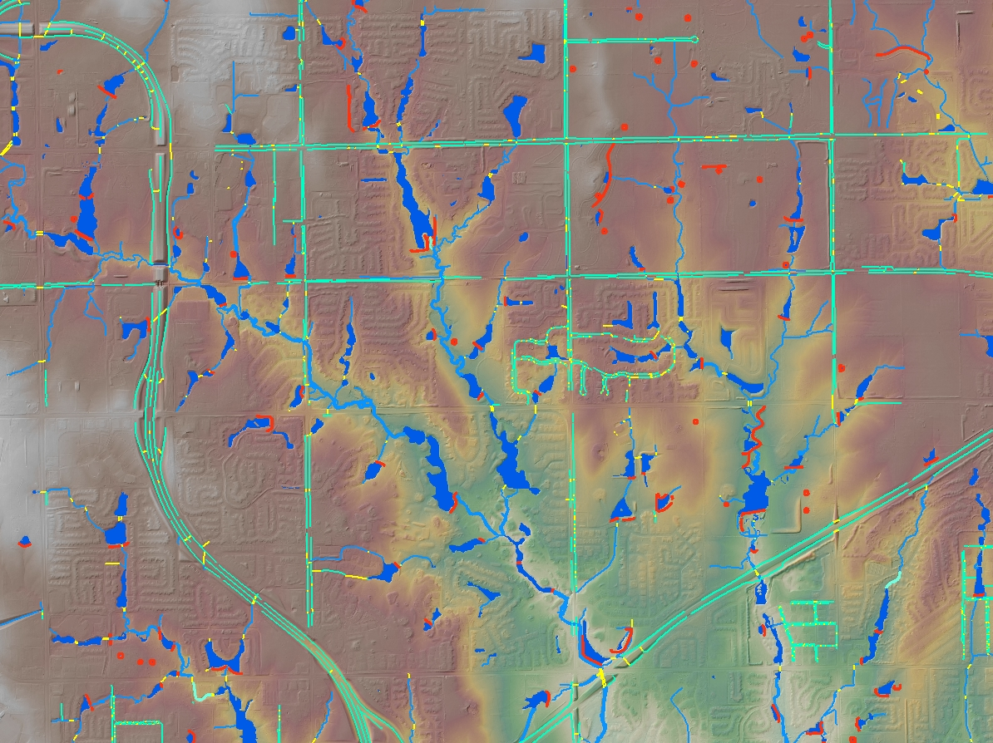
Breaklines
Do You Really Need Breaklines?

Slide 23
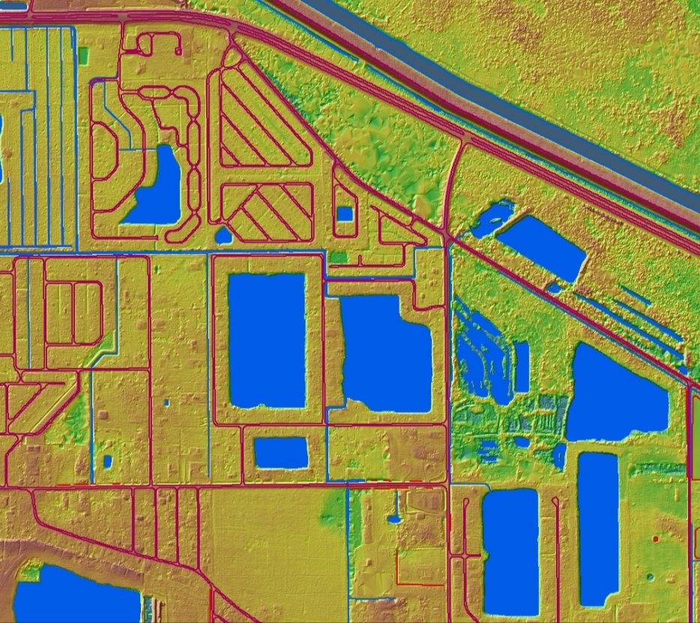
Specifications
Breaklines
Breaklines enforce linear or area features into the LIDAR DEM, thus creating a DTM
Generally two types of breaklines
  Traditional breakline features to meet accuracy specification
  Hydro-enforced breaklines to define the hydrology, very useful for hydrologic & hydraulic modeling and other water resource studies
Be very specific on the specifications

Slide 24

Breakline Collection Approaches
Photogrammetry
Traditional approach
Utilizes stereo models (3D)
Very Accurate
Very Costly
Time Consuming

Slide 25
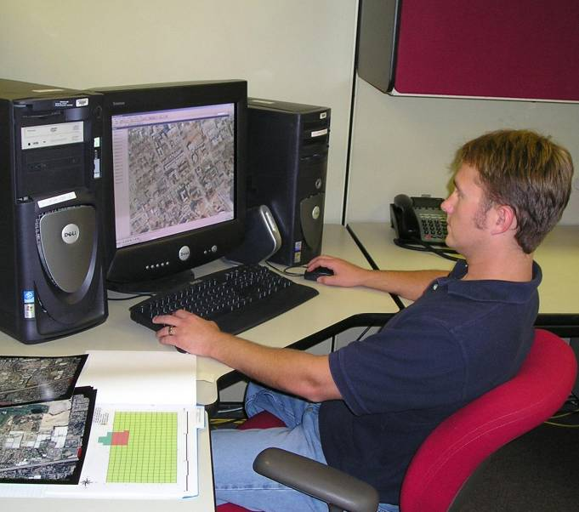
Breakline Collection Approaches (cont.)
Heads-up (2+ D)
Bare-earth LIDAR for vertical (Z)
Effective terrain modeling in vegetated areas
~30% less cost in development
NSSDA (FEMA) surface accuracy requirements
* software dependent
Notes:
Even though overall population growth is quickly becoming more diverse, population growth has slowed pervasively in most areas; more than two thirds of US counties have . A declining population means the loss of skilled workers who move to other areas in search of employment, shrinking sales tax revenues from fewer shoppers, worsening schools, and an area that is attractive to prospective businesses and residents.

Slide 26
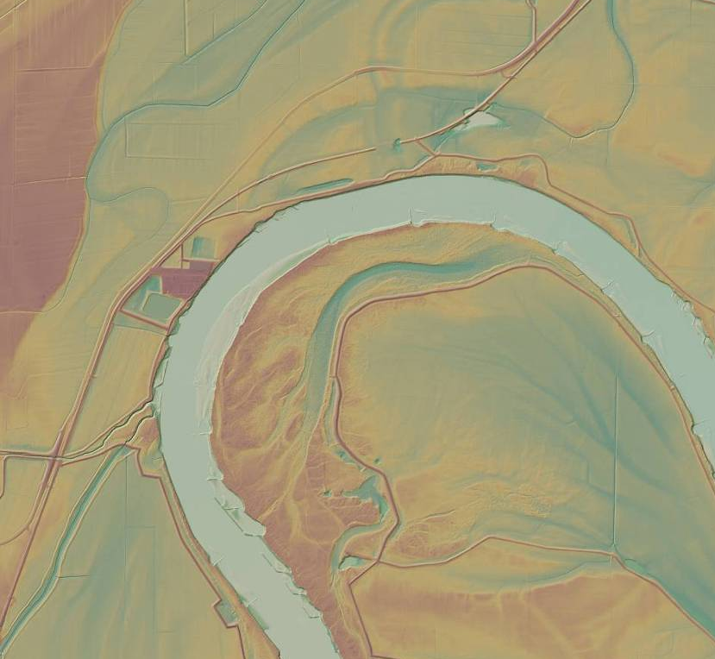
Hydro Breaklines
Hydro breaklines provided allow for DTM development that provides accurate terrain for watershed modeling, hydraulic & hydrologic modeling, drainage area delineation, and stream channel geomorphology studies
Breaklines will go around islands in rivers, lakes, etc.
Waterbodies will be flattened

Slide 27
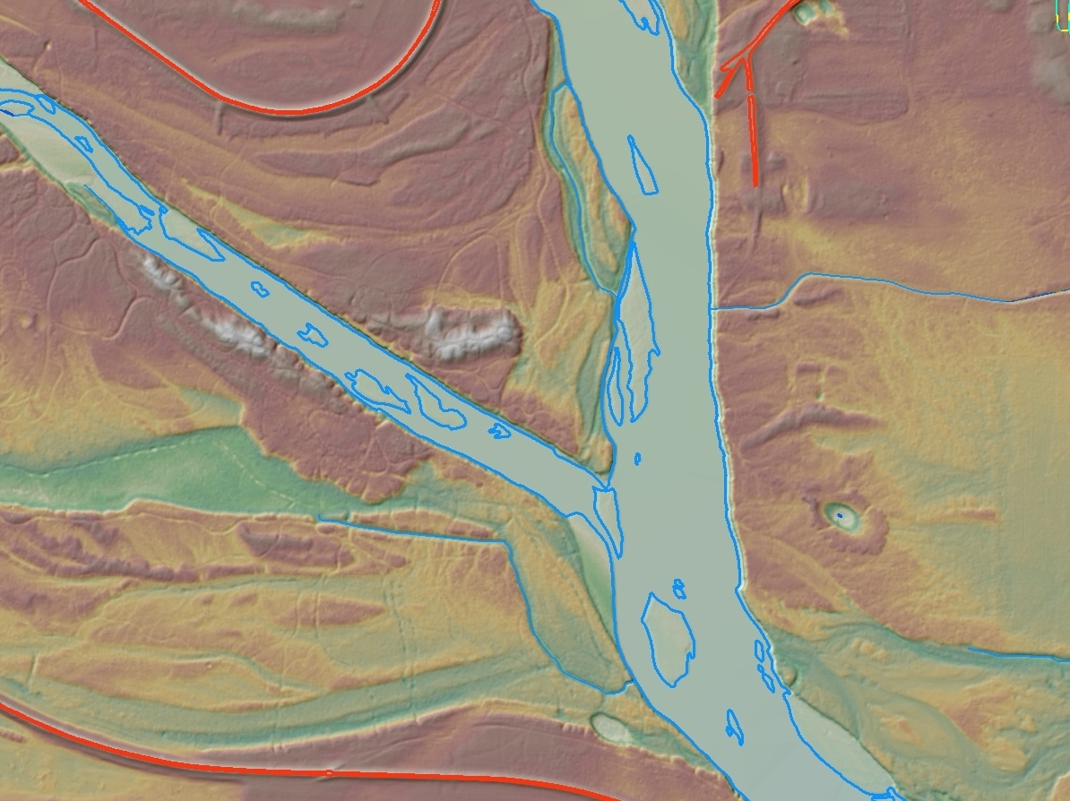
LiDAR and Aerial Imagery Project in Southwest Missouri – Breaklines (cont.)
Linear Features – rivers, streams, ditches
  Minimum length = client define
  Double line breakline – client define
  Breaklines around islands
  Stream width greater = client define
  How to handle culverts – hydro connector
  Bridges – breaklines?
  Dams – cut through?

Slide 28
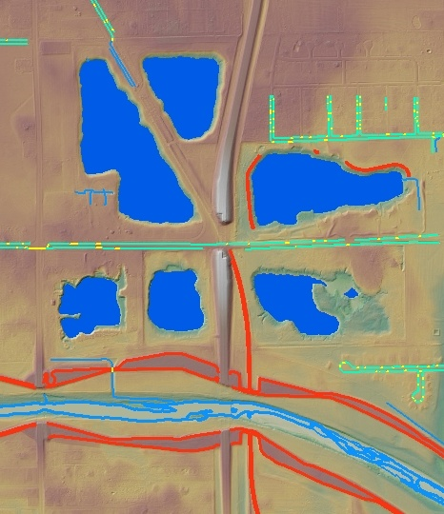
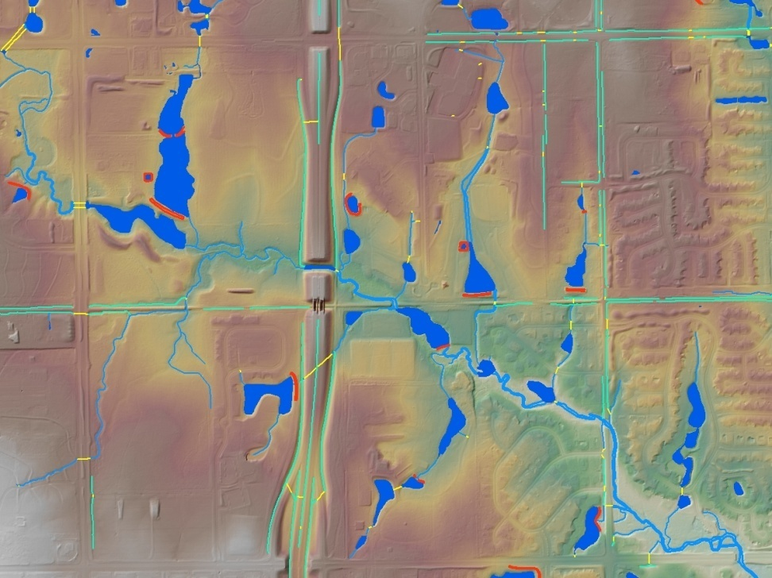
LiDAR and Aerial Imagery Project in Southwest Missouri – Breaklines (cont.)
Waterbodies: Lakes, Ponds (does this include wetlands?) Minimum size of waterbody = client define (recommend ¼ acre)

Slide 29
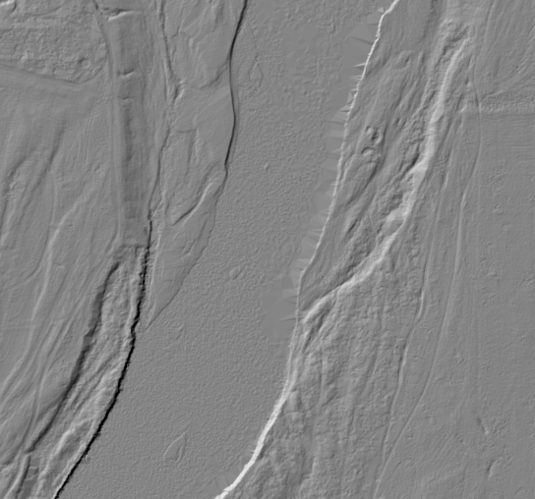
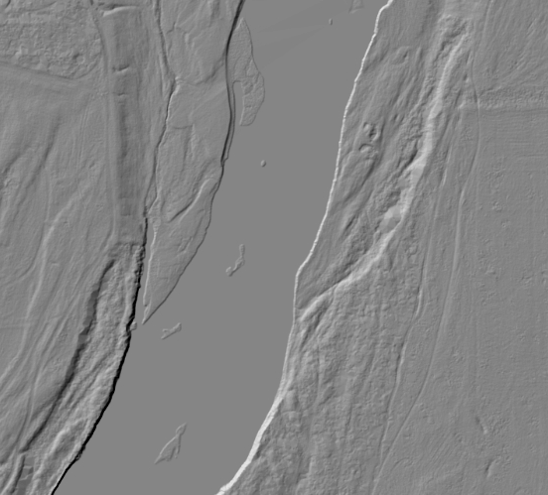
If Breaklines are Not Compiled
With LiDAR data, if breaklines are not specified, hydro features will not be as defined

Slide 30
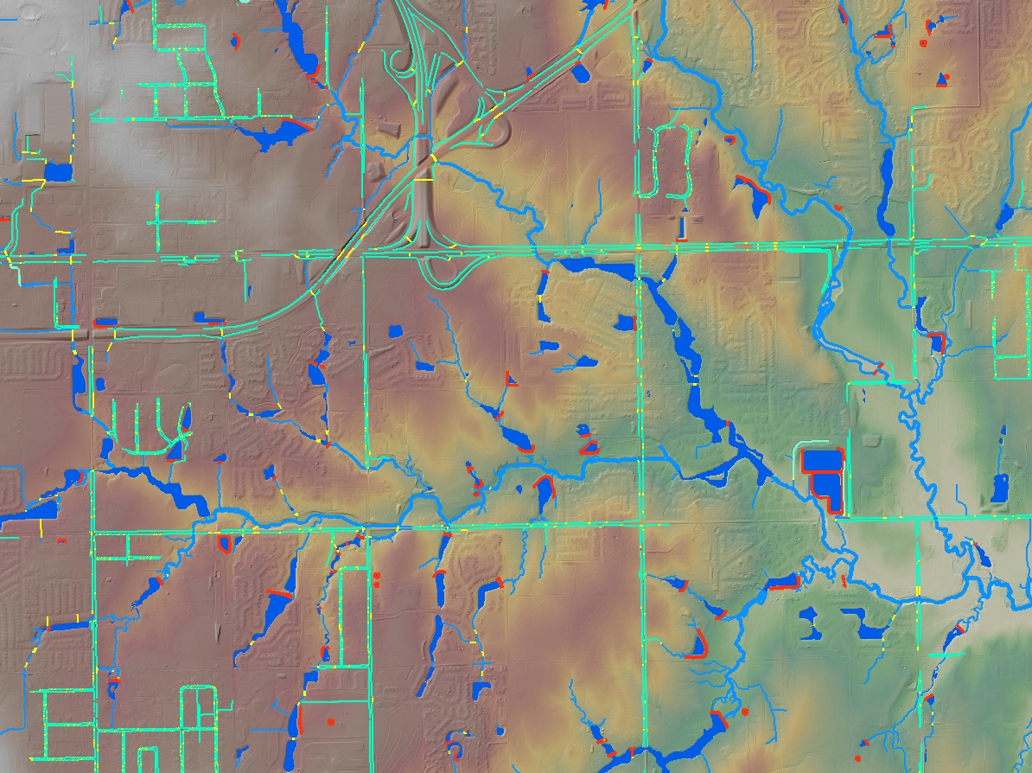
Deliverables
How Do I Know What to Ask For?

Slide 31
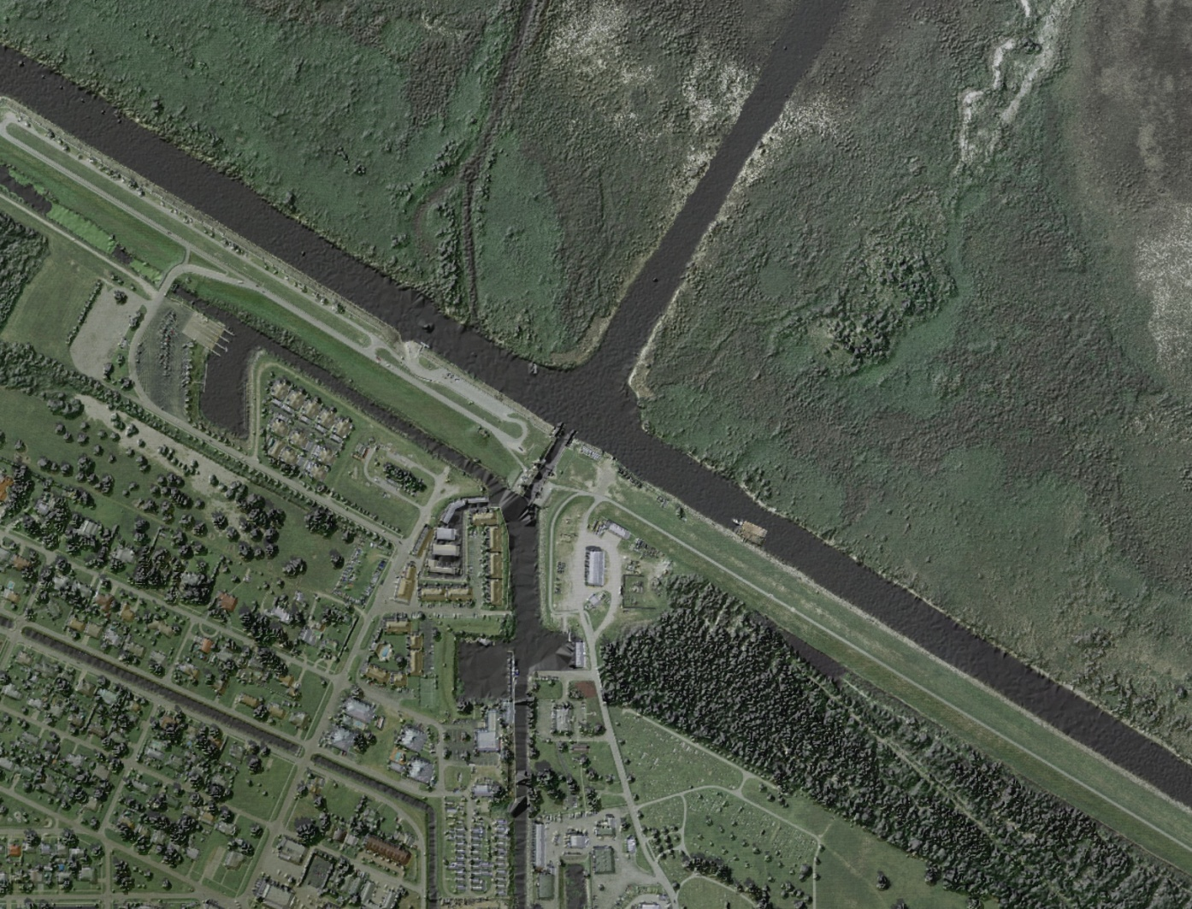
Deliverables
LIDAR
  LAS format (ASPRS LAS Specification) (recommended)
  ASCII format
Raster Elevation (DEM, DTM, etc.)
  ESRI Grid
  ASCII Grid
  Tins

Slide 32
LAS Classifications
Classification Codes Class
0 Created, never classified
1 Unclassified
2 Ground
3 Low Vegetation
4 Medium Vegetation
5 High Vegetation
6 Building
7 Low Point (noise)
8 Model Key-point (mass point)
9 Water
10 Reserved for ASPRS Definition
11 Reserved for ASPRS Definition
12 Overlap Points
13-31 Reserved for ASPRS Definition
32-255 Not reserved currently
*Source: LAS Specification, Version 1.1 (www.lasformat.org)

Slide 33
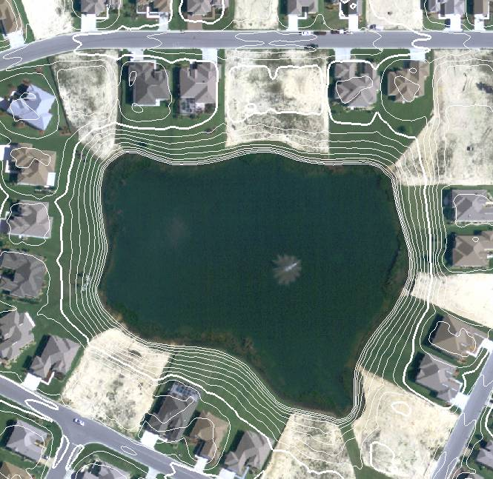
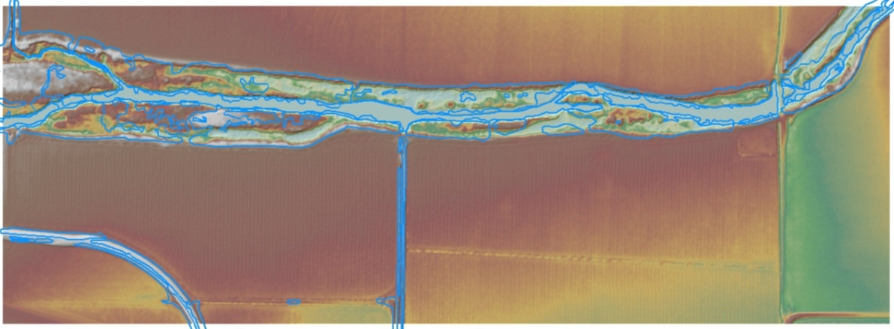
Deliverables (cont.)
Contours
  ESRI Geodatabase
  ESRI Shapefile
  AutoCAD
Breaklines
  ESRI Geodatabase
  ESRI Shapefile
  AutoCAD
Metadata
  xml

Slide 34
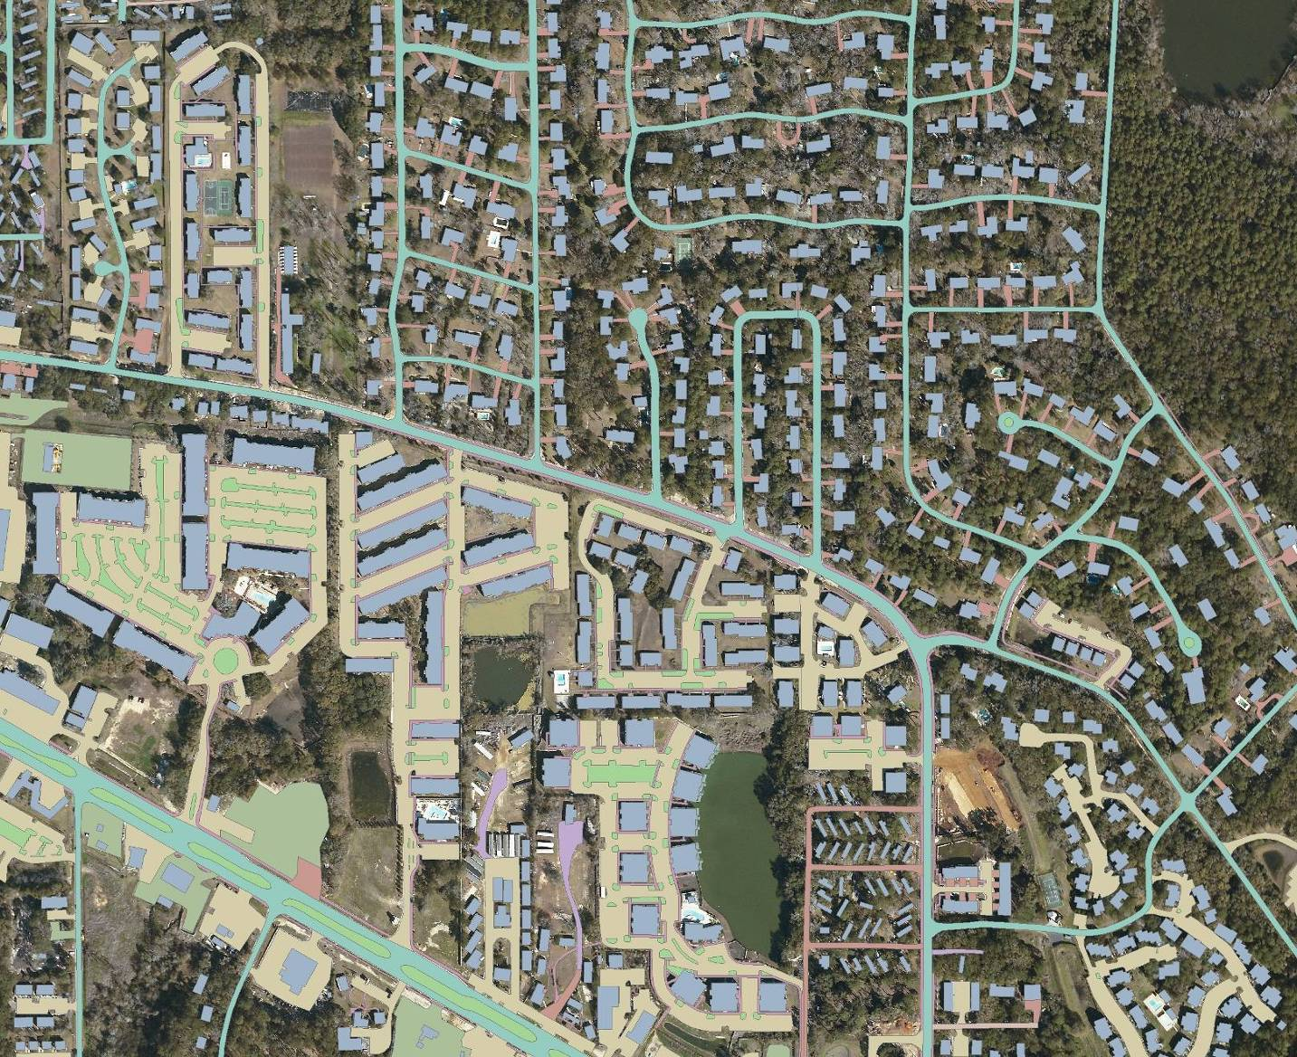
Derivative Products
Above-ground features (ex. vegetation canopy)
Hillshades
Impervious surface
Hydro geodatabase
Feature Extraction (ex. buildings, power lines, etc.)
Fused Datasets

Slide 35
Questions
Kenny Legleiter
Senior Government Account Manager
Merrick & Company
303-353-3837
Kenny.legleiter@merrick.com
www.merrick.com

