Slide 1
Census Data Update
Craig Best
Supervisory Geographer
Kansas City Regional Office

Slide 2
Today’s Discussion Topics
Geographic Products
Demographic Products
Geographic Support System Initiative (GSS)

Slide 3
Census Bureau Geography
The integrating factor for all U.S. Census Bureau products. The framework on which the data rest.
The key to mapping the data is the Geographic Identifier (GEOID)
Each piece of census geography has a unique GEOID

Slide 4
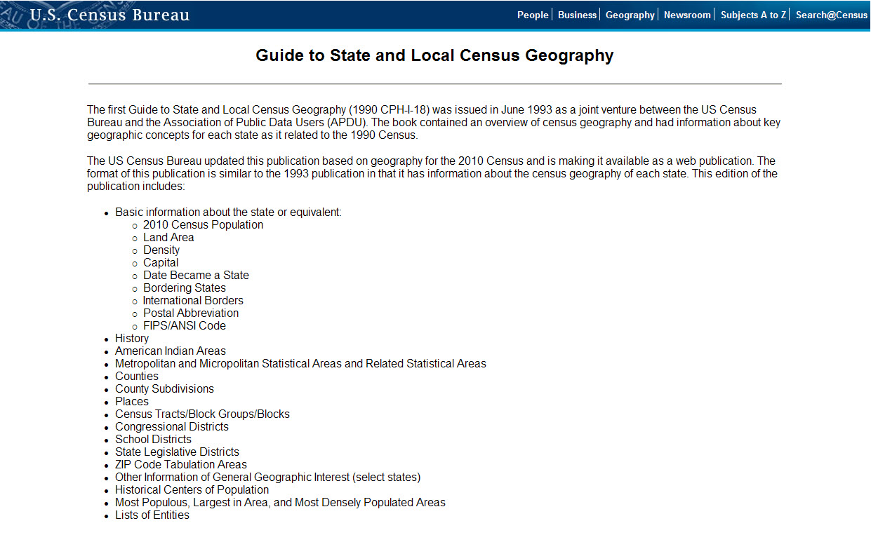
Guide to State and Local Census Geography
http://www.census.gov/geo/www/guidestloc/guide_main.html

Slide 5
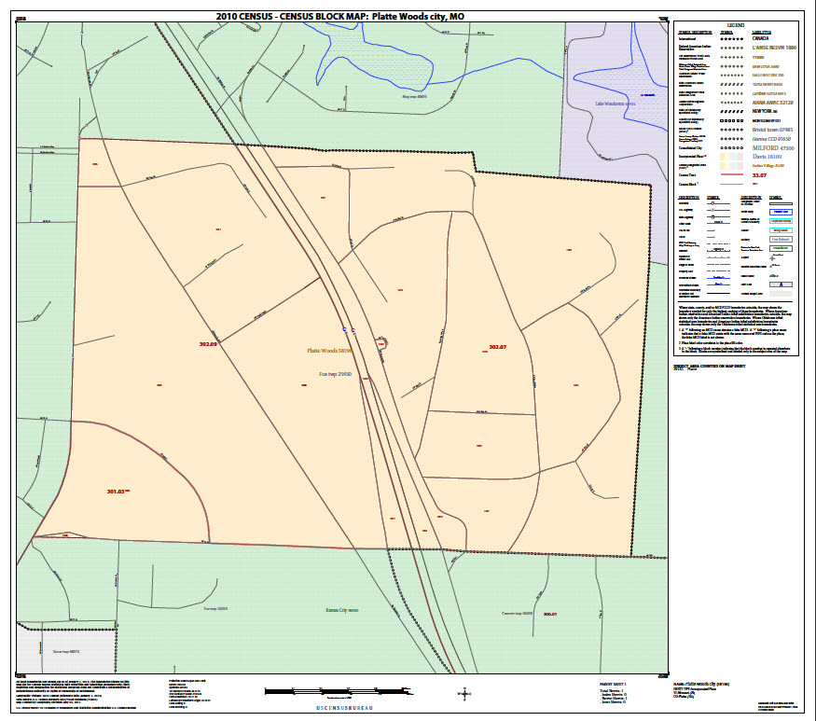
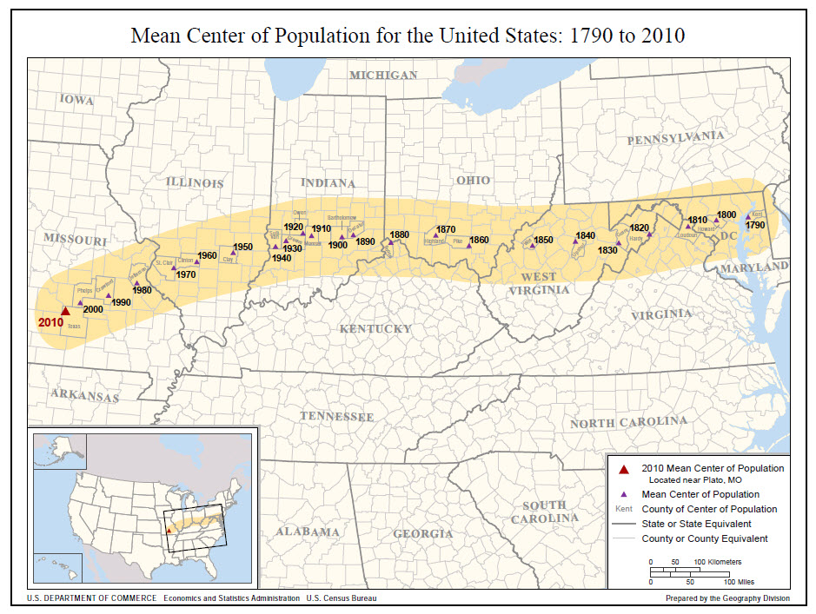
Good Ole Census Maps
2010 Census Reference
  Census Block Maps
  Census Tract Reference Maps
  School District Reference Maps
  P.L.94-171 County Block Maps
  P.L.94-171 VTD/SLD Reference Maps
  2010 Census Reapportionment Map
  2010 Census Local Census Offices with Type of Enumeration Areas
Census Geography (2000 and 1990)
  American Indian Tribal Census Tract Outline Maps:
  Description 2000
  American Indian/Alaska Native/Hawaiian Home Land Block Maps:
  Description 2000
  Census Block Maps: (Also available on DVD)
  Description 2000 | 1990
  Census Tract Outline Maps: (Also available on DVD)
  Description 2000 | 1990
2007 Economic Census Maps
  State, County and Combined Statistical/Metropolitan/Micropolitan Area (CBSA) Maps
General Reference
  State/County Wall Map of the United States:
  2010 | 2003
  State-based County Outline maps (page-size):
  Description 2000 | 1990
  State/County Subdivision Outline Maps (page-size):
  2000
  Census Regions and Divisions of the United States:
  [PDF] or [Text]
Partnership Program Maps
  Boundary and Annexation Survey Maps
Congressional District Maps Congressional District Map Products
  112th Congressional District Maps
  111th Congressional District Maps
  110th Congressional District Maps
  109th Congressional District Maps
  108th Congressional District Maps
Metropolitan Areas Maps
  Metropolitan and Micropolitan Statistical Areas Wall Maps:
  2009 | 2008 | 2007 | 2006 | 2005 | 2004 | 2003
  State-based Metropolitan and Micropolitan Statistical Areas maps (page-size):
  2004 | 2003
  New England City and Town Area Wall Maps:
  2006 | 2003
  State based Metropolitan Areas maps (page-size):
  1999
  U.S. based Metropolitan Areas maps (page-size):
  1999
  Metropolitan Areas of the United States and Puerto Rico (wall map):
  1999
  New England Metropolitan Areas (wall map):
  1999
Census 2000 Public Use Microdata Area (PUMA) Maps
  Super-Public Use Microdata Area (Super-PUMA) Maps (1-percent sample):
  Description 2000
  Public Use Microdata Area (PUMA) Maps (5-percent sample):
  Description 2000
Urban Areas
  Urbanized Area (UA) Outline Maps (wall-size):
  Description 2000
  Urban Cluster (UC) Outline Maps (wall-size):
  Description 2000
Census 2000 Redistricting Data Program Maps
  (Available on DVD and CD-ROM) P.L. 94-171 County Block Maps:
  Description 2000
  P.L. 94-171 Voting District/State Legislative District Outline Maps:
  Description 2000
THEMATIC MAPS (description)
  Population Density:
  2010 [PDF]
  Total Population & Population Change:
  2010
  Population Profiles:
  2010 | 2000
  Centers of Population:
  2010 | 2000 | Historical
  Population Distribution of the United States:
  2010 | 2000 | 1990
SPECIAL PURPOSE MAPS
  May 2011 Mississippi River Flood Area Resource Maps
  The American Indians and Alaska Natives in the United States Wall Map
  2010 | 2000
  Mapping Census 2000: The Geography of U.S. Diversity
  Description 2000
  Census Regions and Divisions of the United States
  [PDF] or [Text]

Slide 6
Mapping Files
Product | Best For… | File Format | Type of Data | Level of Detail | Descriptive Attributes
TIGER/Line Shapefiles | Most mapping projects--this is our most comprehensive dataset. Designed for use with GIS (geographic information systems). | Shapefiles (.shp) and database files (.dbf) | Boundaries, roads, address information, water features, and more | Full detail (not generalized) | Extensive
Cartographic Boundary Files | Small scale (limited detail) mapping projects clipped to shoreline. Designed for thematic mapping using GIS. | Shapefiles (.shp) | Selected boundaries | Less detail (generalized) | Limited
KML | Viewing data or creating maps using Google Earth, Google Maps, or other platforms that use KML. | KML (.kml) | Selected boundaries | Less detail (generalized) and detailed | Limited

Slide 7
TIGER/Line Files
Have been around since the 1990 Census
First release was in 1988
Currently available for download as shapefiles
State and County based
FTP and web interface
WFS option is in the works

Slide 8
TIGER/Line Files
Provides the most detail
State and County based files
Files for Geographic Areas
  State, county, tract, block groups, block, school districts, legislative districts, etc
Files for Features
  Roads, rails, hydro, landmarks, military installations

Slide 9
TIGER/Line Files
Good for mapping at the state, county, or sub-county level
Best product for spatial analysis

Slide 10
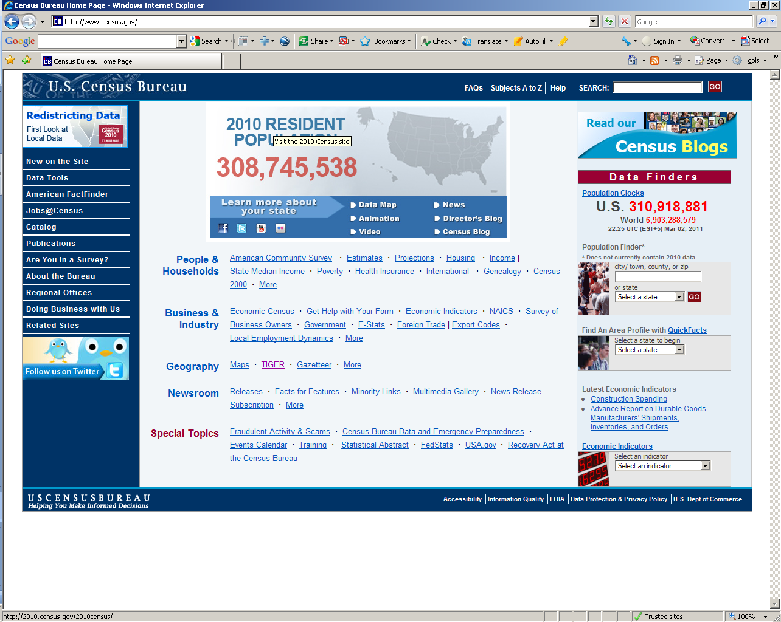
www.census.gov
http://www.census.gov

Slide 11
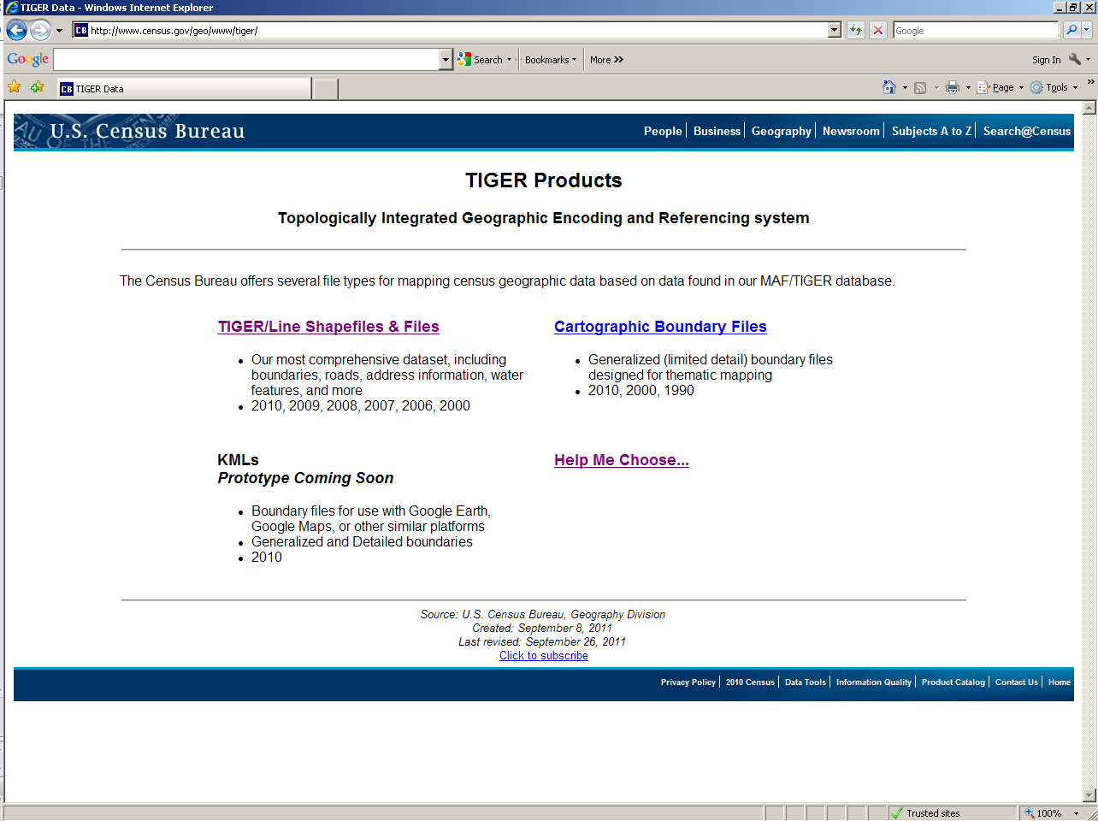

Slide 12
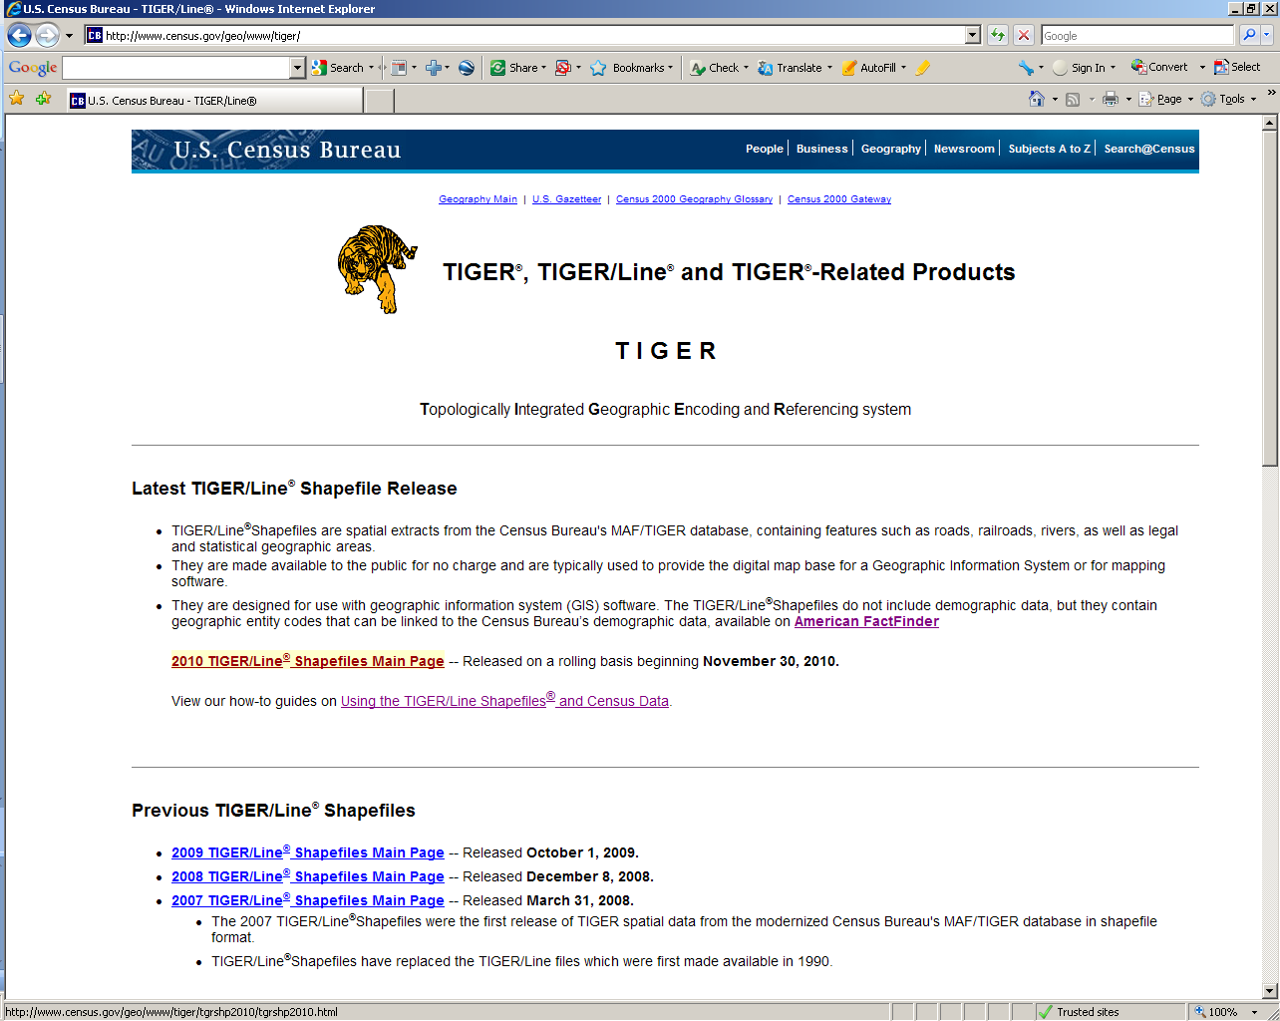

Slide 13
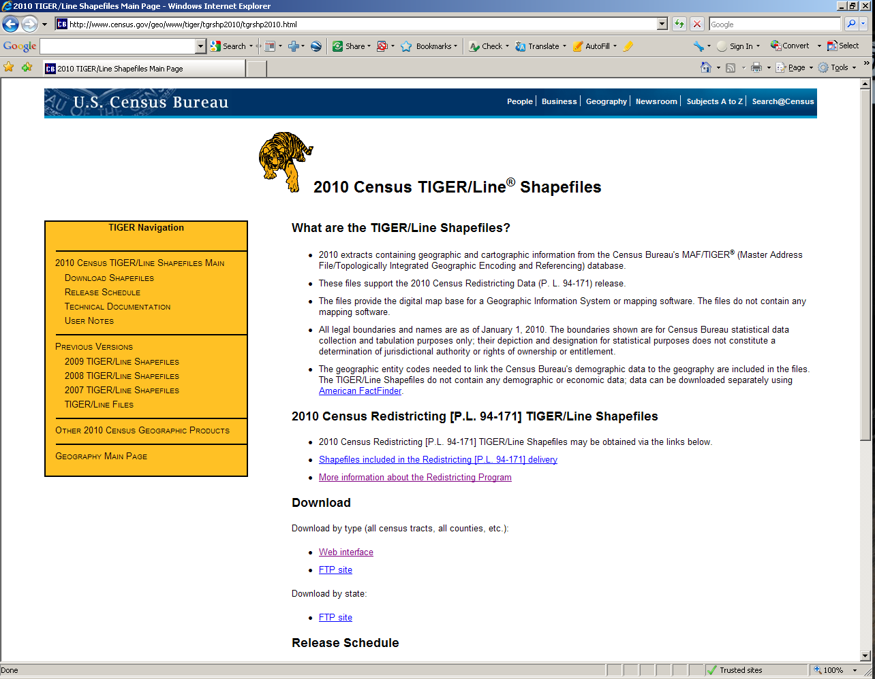

Slide 14
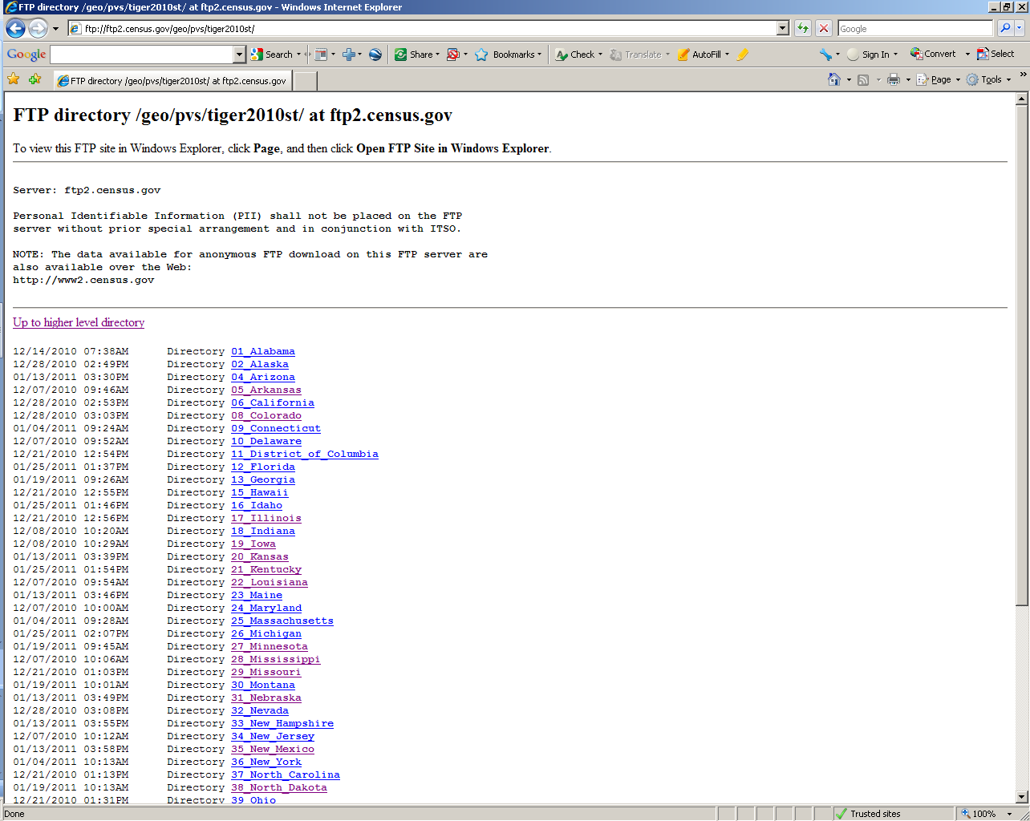

Slide 15
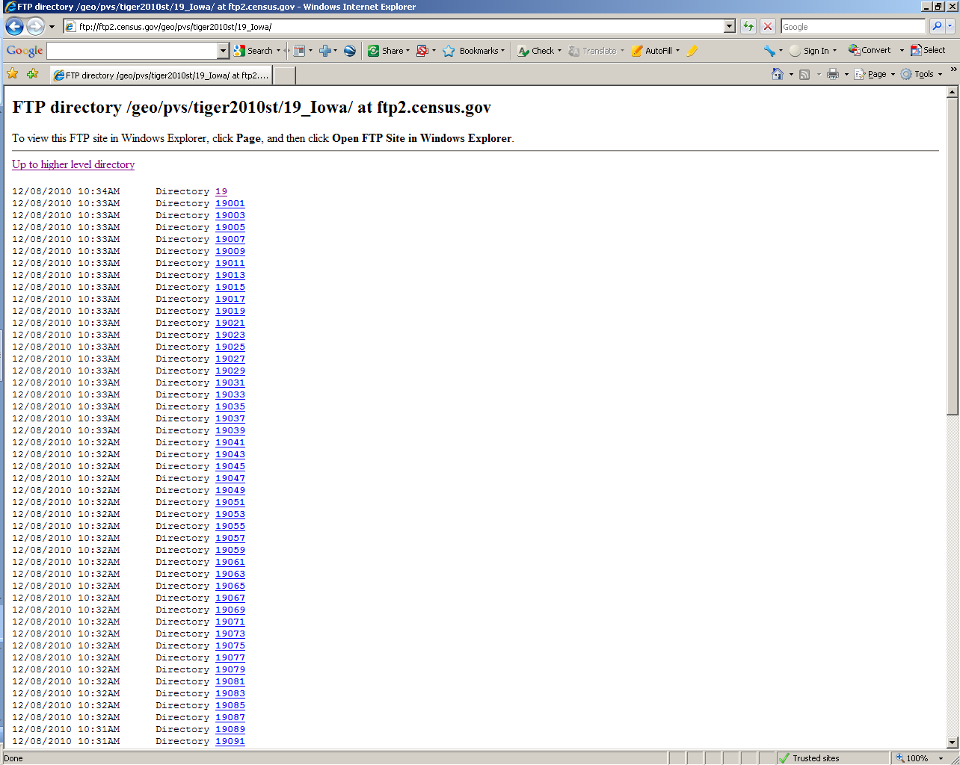

Slide 16
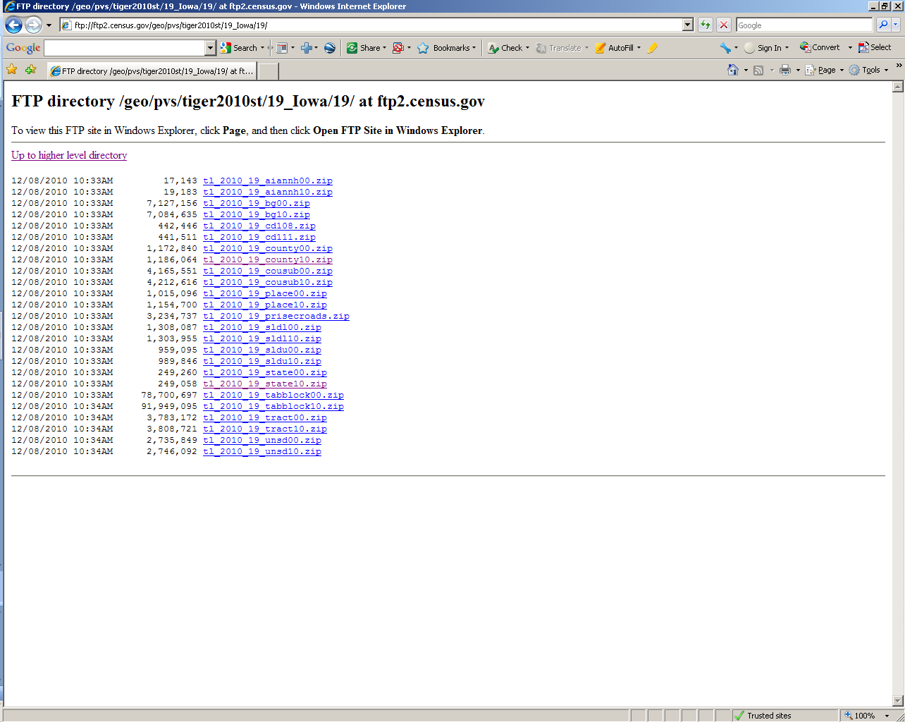

Slide 17
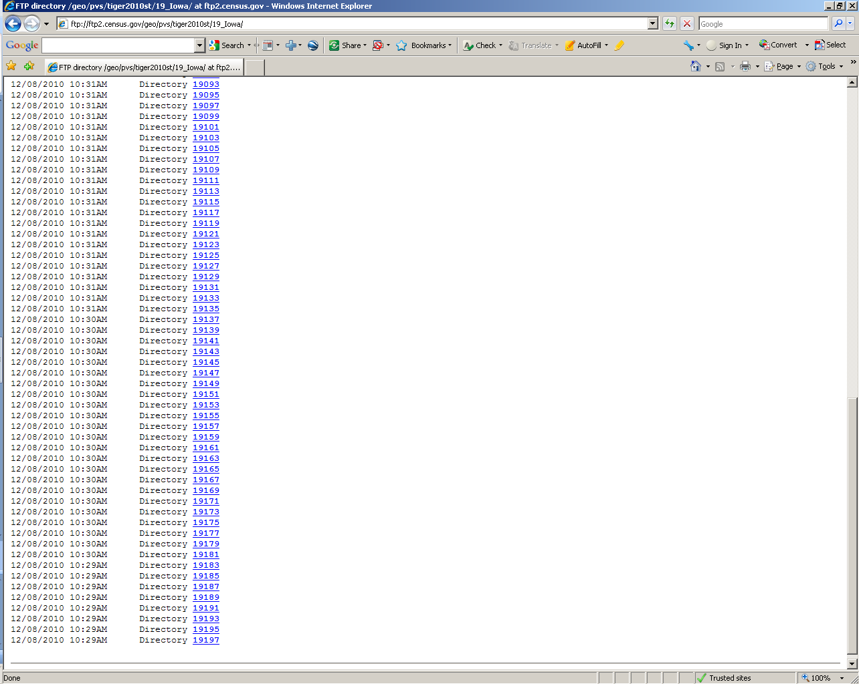

Slide 18
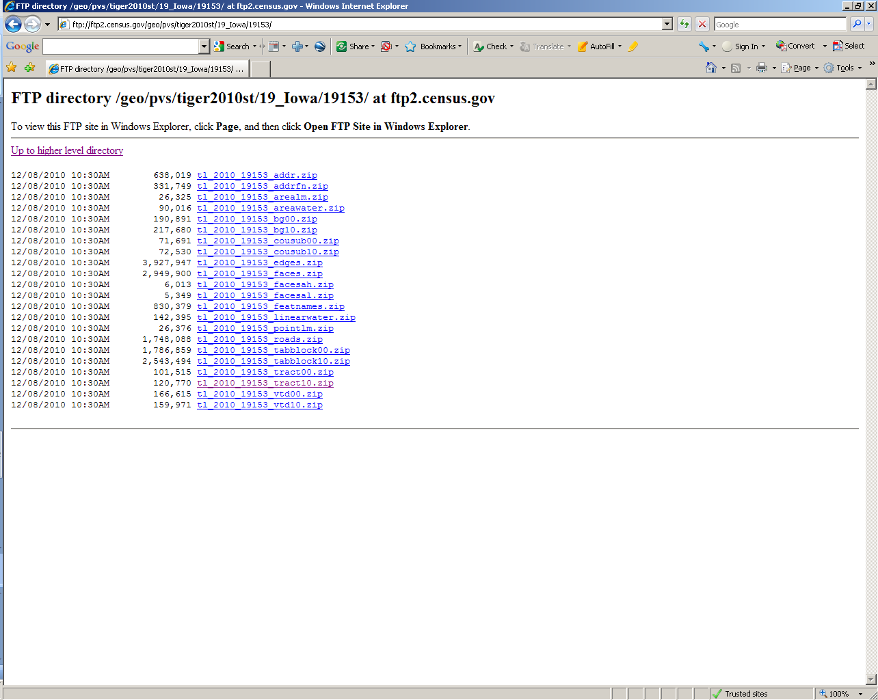

Slide 20
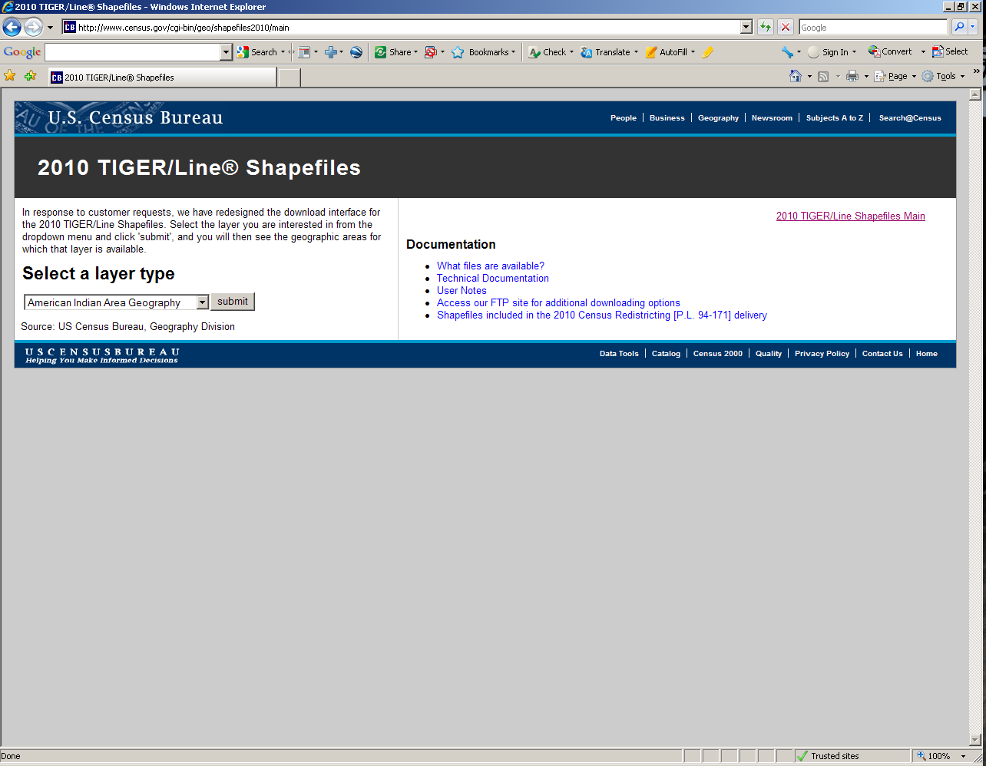

Slide 21
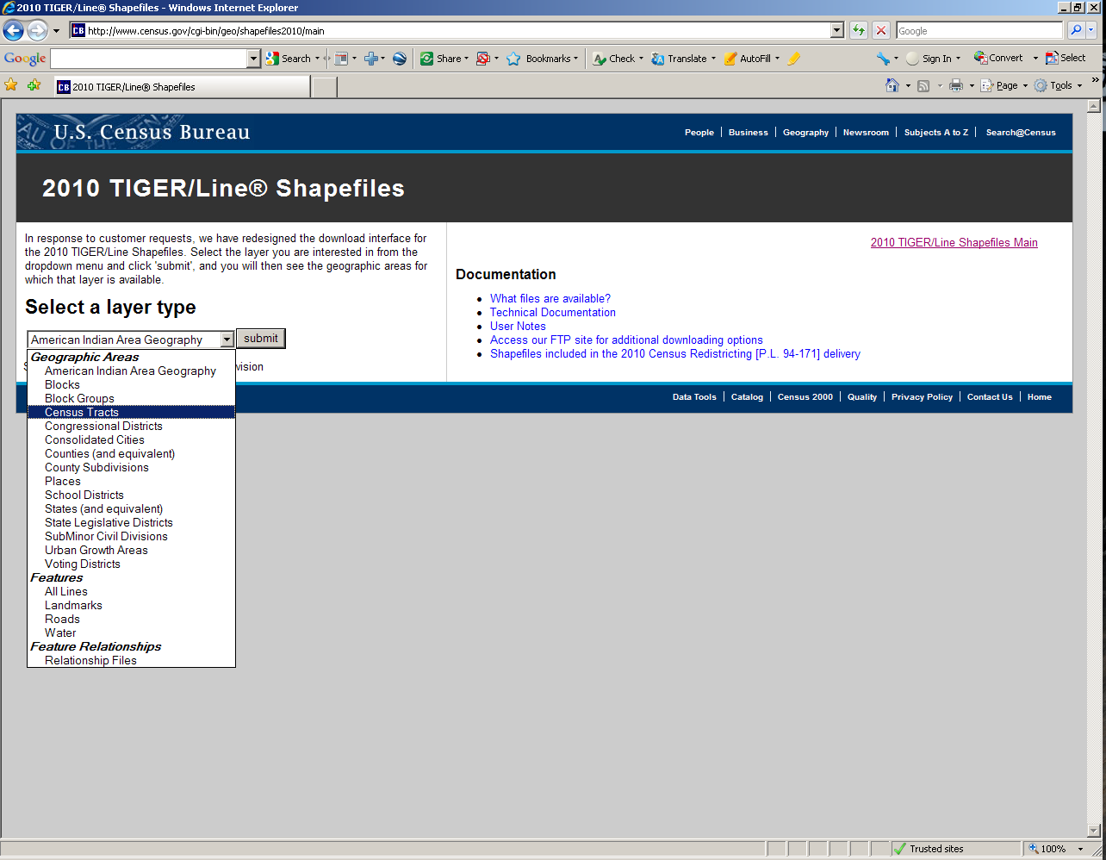

Slide 22
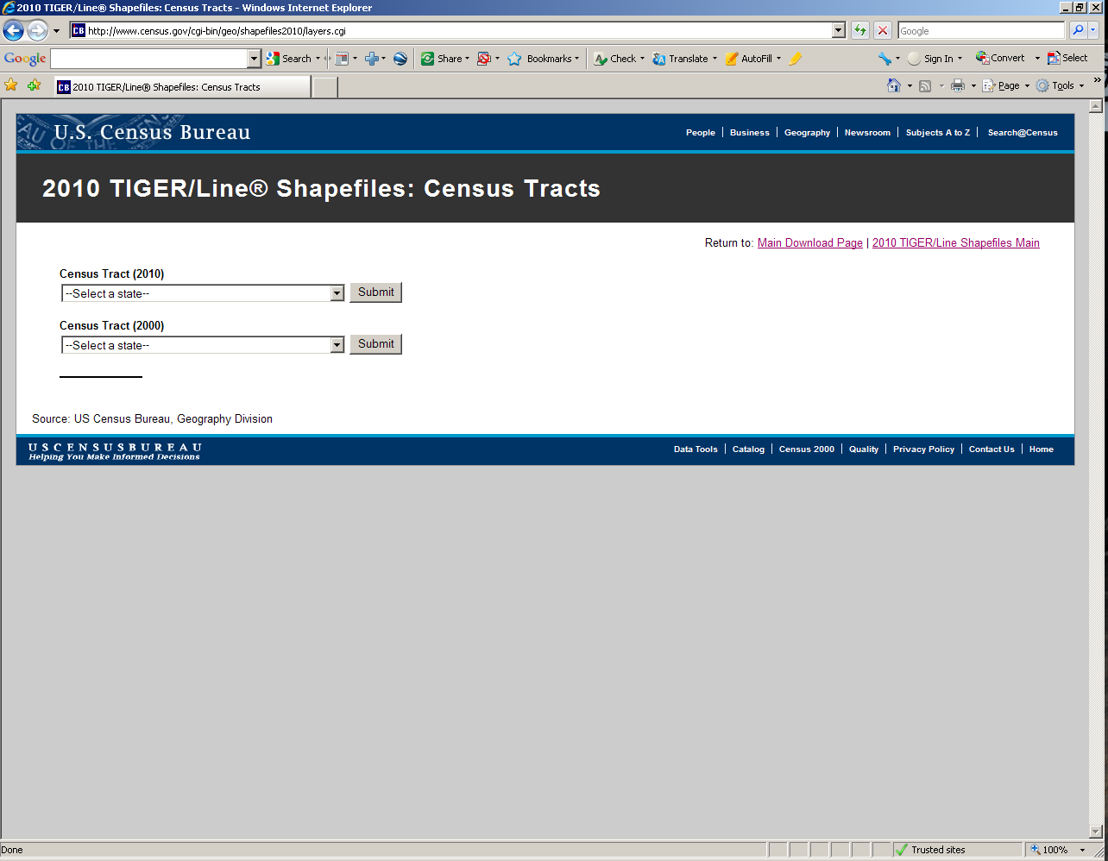

Slide 23
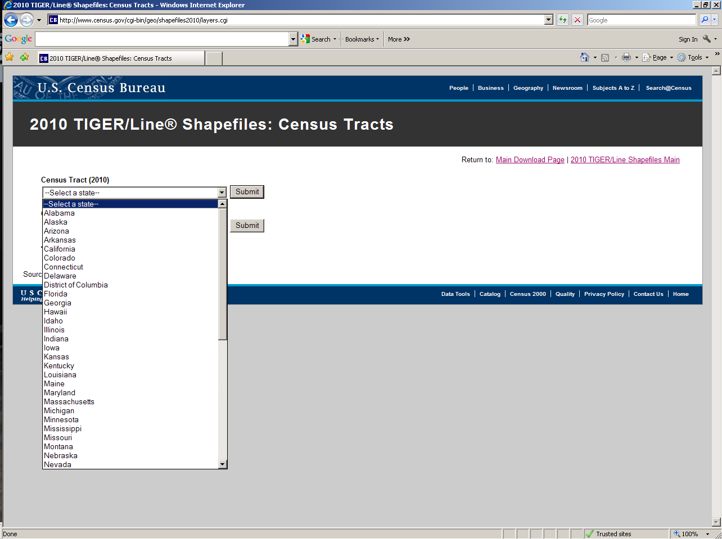

Slide 24
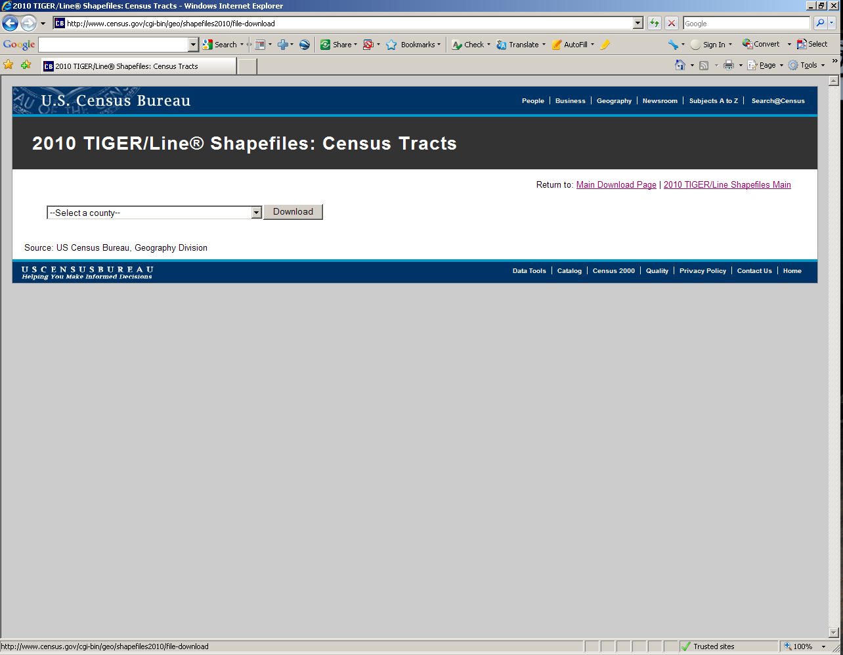

Slide 25
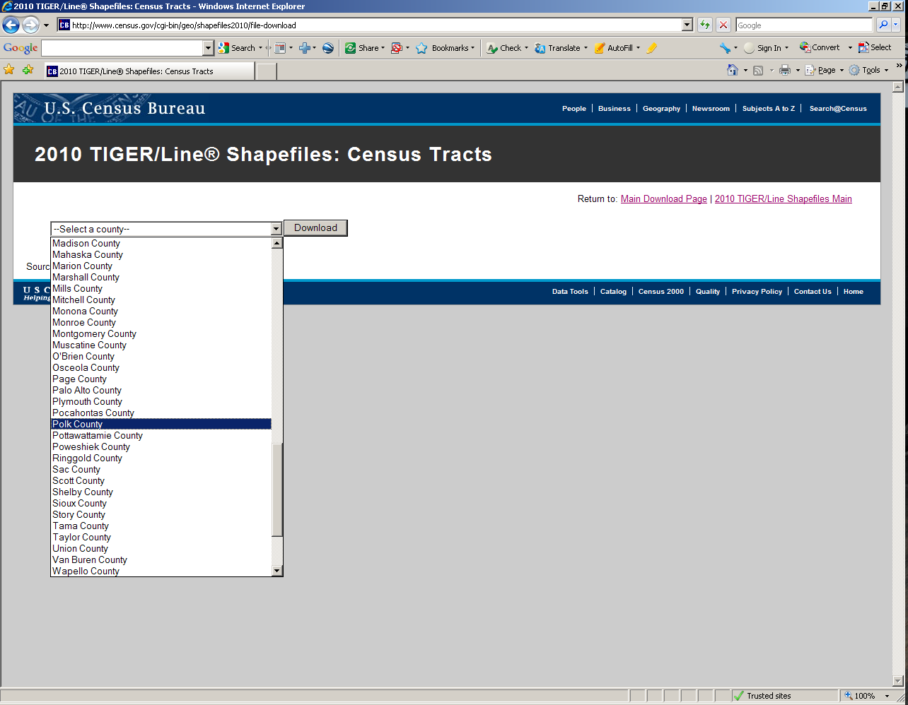

Slide 26
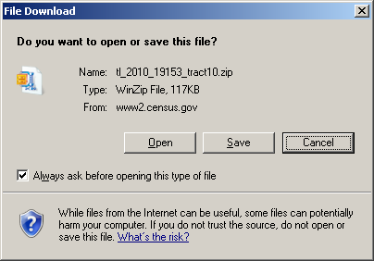

Slide 27
Cartographic Boundary Files
State level files for selected geographies
These are generalized files…
  Line segments removed to simplify boundaries
  Significantly reduces the size of the files
CAUTION!! Don’t mix county based TIGER/Line files with Cartographic Boundary files

Slide 28
COB Advantages
Simplified shapes improve the appearance of geographic areas when displayed at small scales.
These boundary files take up less disk space than their ungeneralized equivalents.
Cartographic boundary files take less time to render on screen.

Slide 29
COB Limitations
These files should not be used for:
  geographic analysis including area or perimeter calculation.
  geocoding addresses.
  determining precise geographic area relationships.
Some geographic areas are excluded from these files.
Geographic areas may not align with the same areas from another year.

Slide 30
COB Scale
Files are available at target map scales of:
  State Level
    1:500,000
  National Level
    1:5,000,000
    1:20,000,000

Slide 32
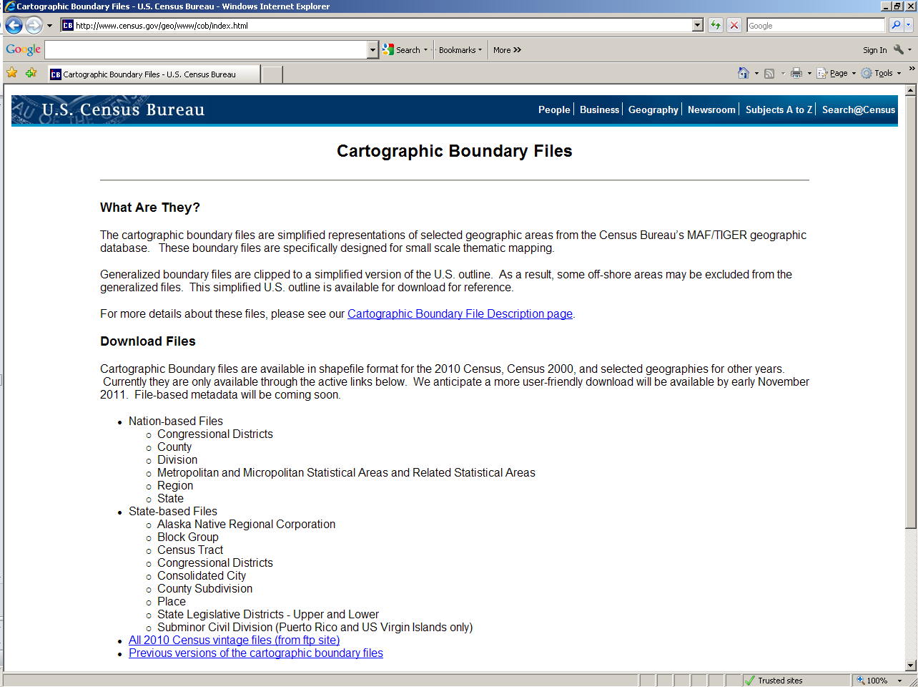

Slide 33
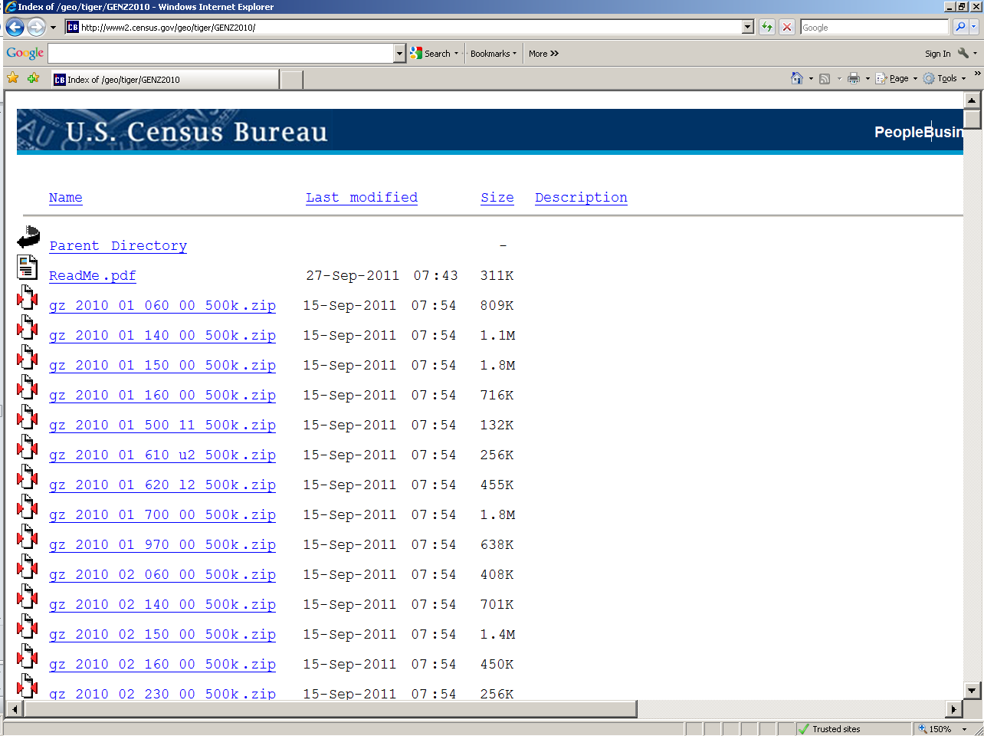

Slide 34
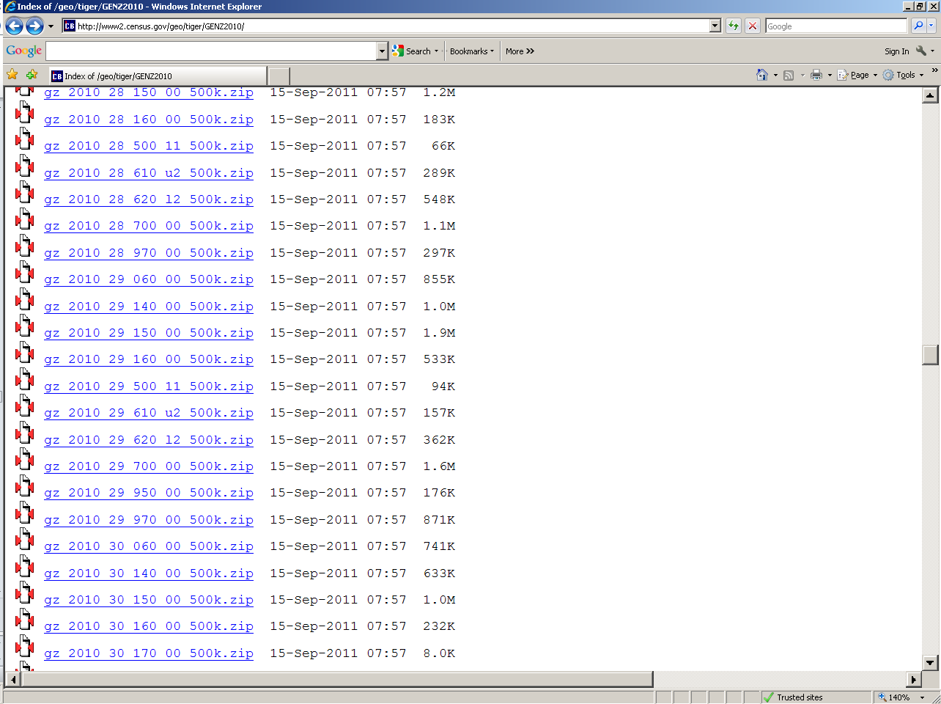
Refer to document entitled “Cartographic Boundary File Summary Level Codes” to determine the layer type.

Slide 35
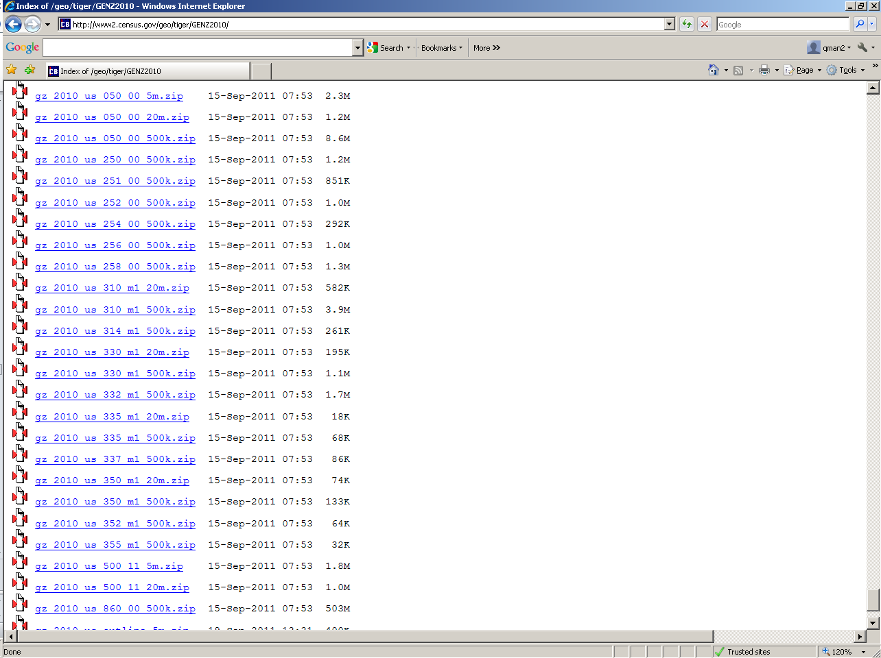
US files at the bottom of the page.

Slide 36
KMLs
Prototypes coming very soon
“Testing the Market”
Initial release to include County and Census Tract

Slide 38
SF1 Data

Slide 39
What is Summary File 1?
Contains data compiled from the questions asked of all people at every housing unit
Population items include sex, age, race, Hispanic or Latino Origin, household relationship, household type, household size, family type, family size and group quarters

Slide 40
SF1 Continued
Housing items include occupancy status, vacancy status, and tenure.
Data available at all census geographic levels
From just 10 questions, SF1 provides 331 tables of data.

Slide 41
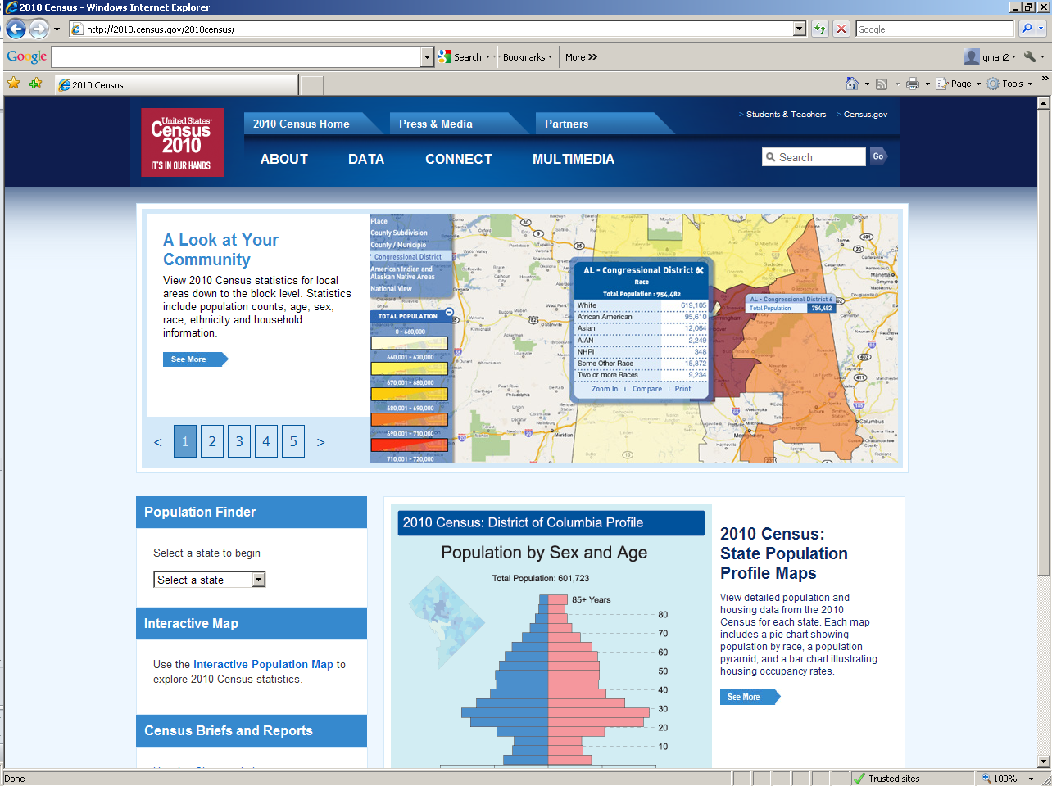
2010census.gov

Slide 42
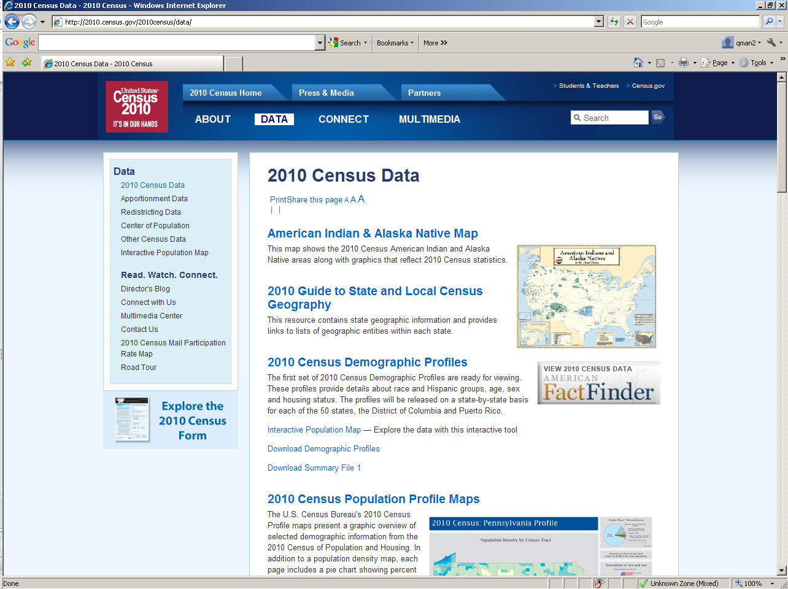

Slide 43
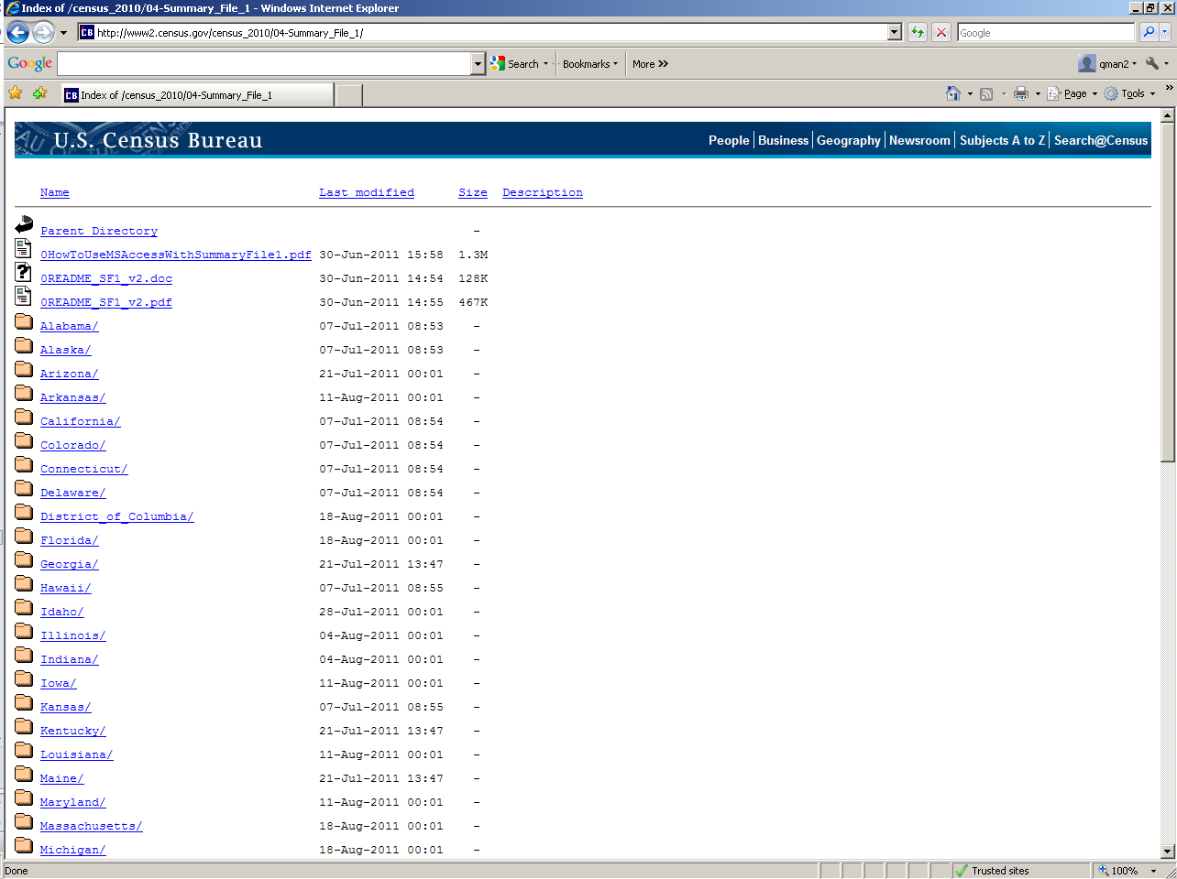

Slide 44
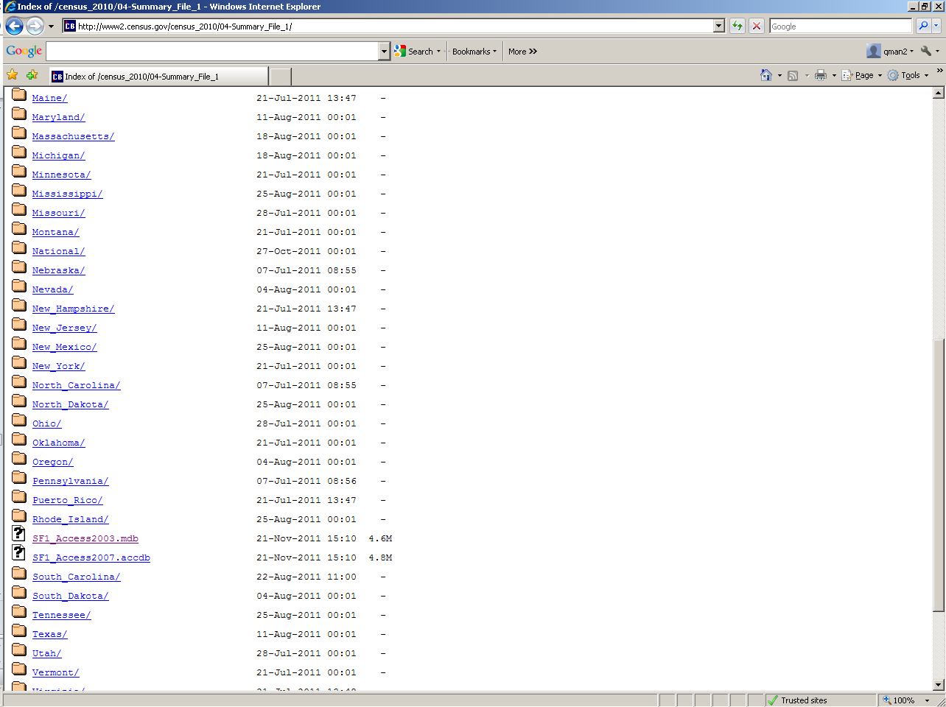

Slide 45
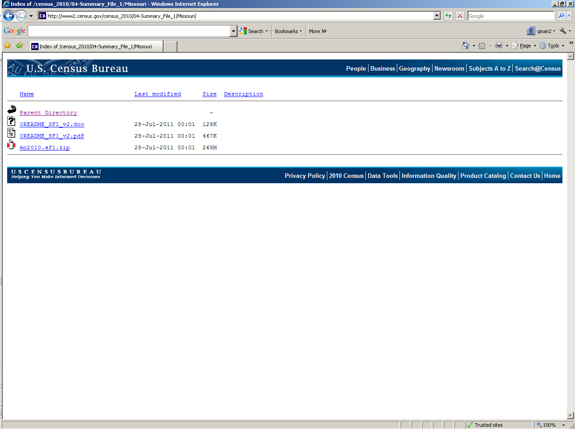

Slide 46
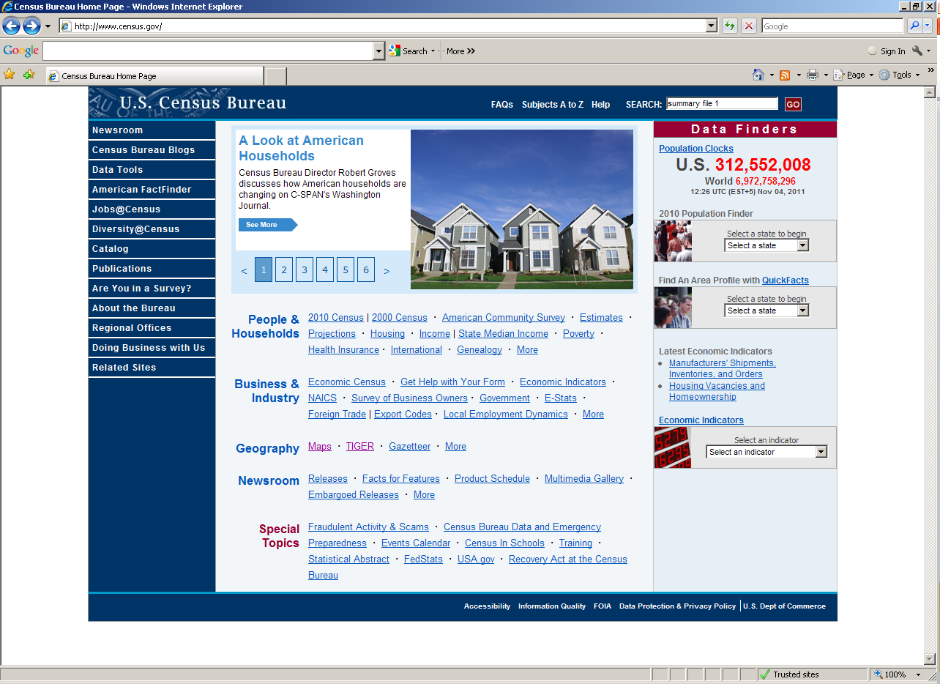

Slide 47
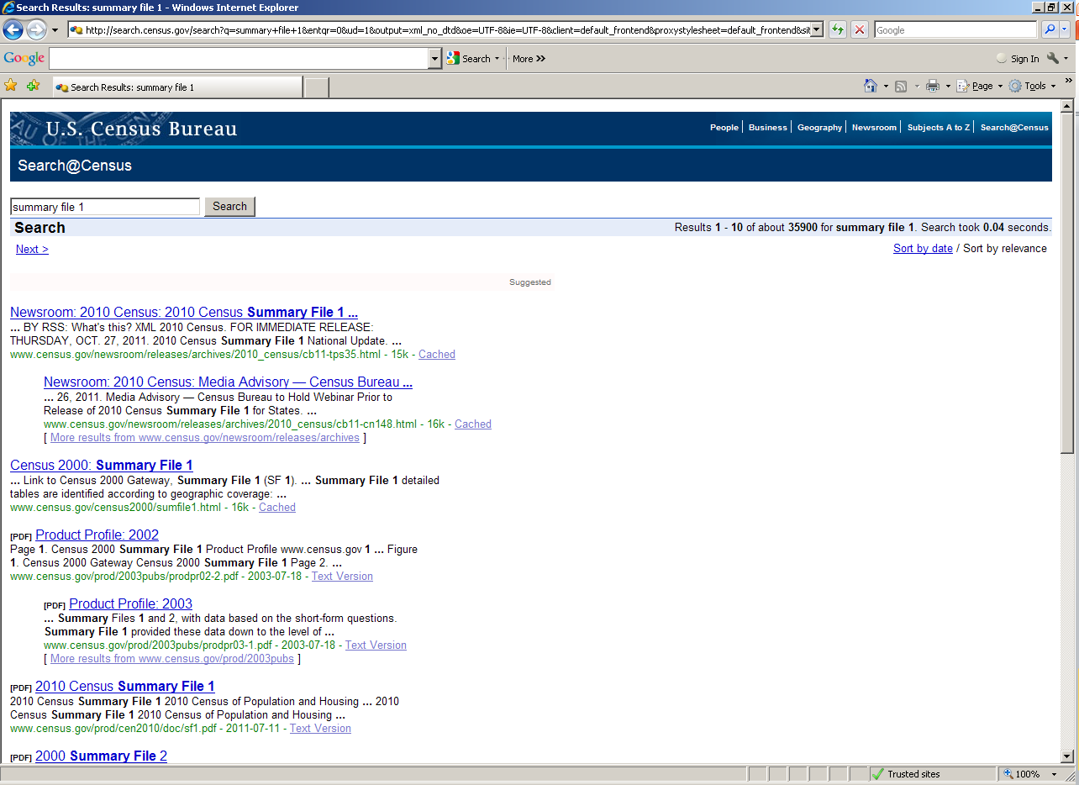

Slide 48
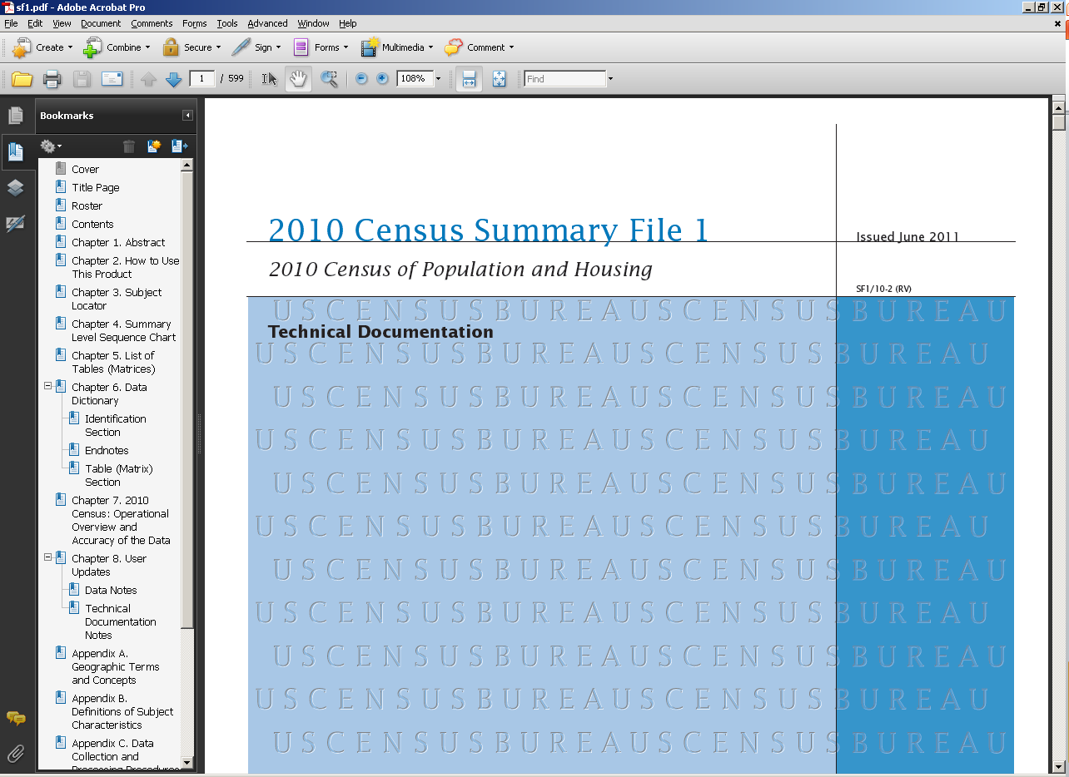

Slide 49
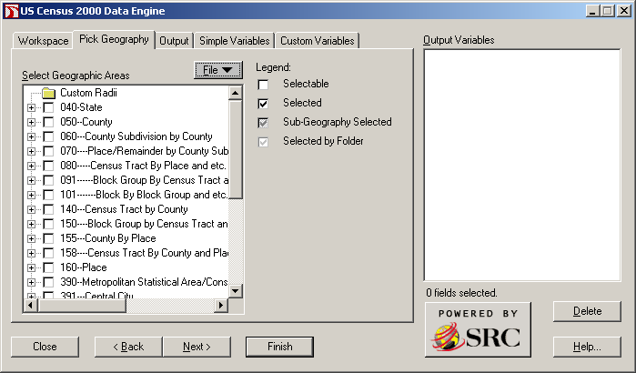
Allocate is Coming!

Slide 50
American FactFinder

Slide 51
What is the American FactFinder?
A Data Access Website
Searches by
  Topics
  Geographies
  Population Groups
  Industry Codes

Slide 52
What is the American Factfinder?
Provides quick access to data from
  Decennial Census
  American Community Survey
  Population Estimates Program
  Economic Census
  Annual Economic Surveys

Slide 53
For now, there are 2 AFFs
The most current version is called American Fact Finder 2 (AFF2)
Legacy data is being transitioned into AFF2
Upon completion, AFF will go off-line

Slide 54
How Do I Get to It?
factfinder2.census.gov or
www.census.gov, and click on the American FactFinder Link

Slide 55
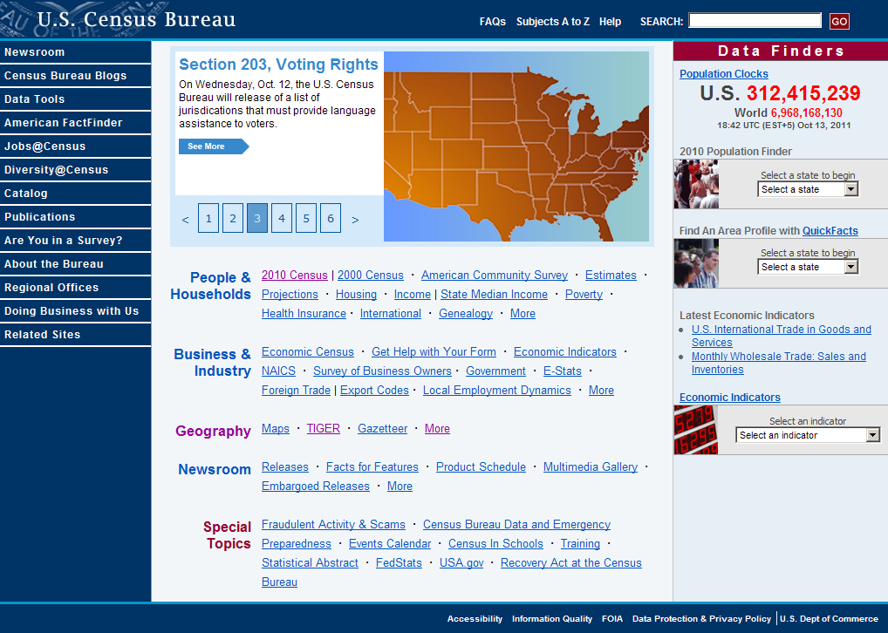

Slide 56
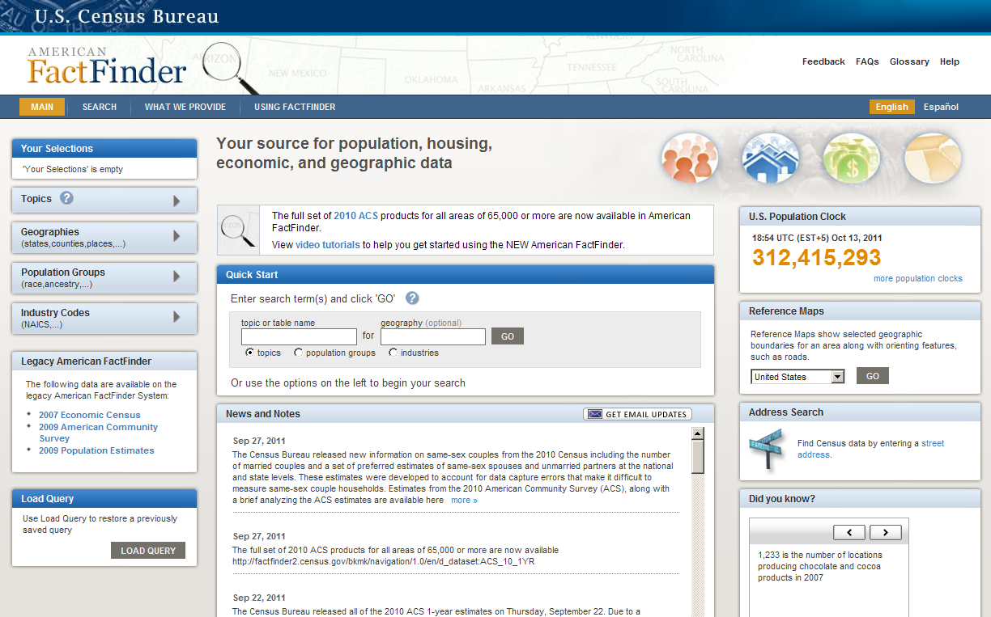

Slide 57
Geographic Support System Initiative (GSS)

Slide 58
What Is It?
Integrated program in support of the 2020 Census:
  Improved address coverage
  Continual spatial feature updates
  Enhanced quality assessment and measurement

Slide 59
What Are We Doing?
The GSS Initiative will focus on ensuring a complete and updated address list. All activities will contribute to Master Address File/Topologically Integrated Geocoding and Referencing System (MAF/TIGER) database improvement.

Slide 60
Why Are We Doing It?
The GSS Initiative will allow for a targeted, rather than full, address canvassing operation during 2019 in preparation for the 2020 Census. The Census Bureau will collaborate with federal, state, local, and tribal governments and other key stakeholders to establish an acceptable address list for each geographic entity.

Slide 61
Geographic Contact
Craig Best
Supervisory Geographer
US Census Bureau
1211 N 8th St, Kansas City, KS 66101
913-551-6833
craig.duane.best@census.gov

Slide 62
Demographic Contact
Matthew Milbrodt
Information Services Specialist
US Census Bureau
1211 N 8th St, Kansas City, KS 66101
913-551-6711
matthew.s.milbrodt@census.gov

Slide 63

Questions?

